Slide 1
Generative AI from first principles
Madhusudhan Reddy Pittu

Slide 2
Lecture 1: (Artificial) Intelligence, Learning, Language, and Meaning
Short timeline highlighting language and its modeling, course description: what we will study and build
Basic AI/ML/DL terminology
Understanding
  Intelligence
  Learning
  Language
  Meaning
Hands-on: an autograd engine

Slide 3
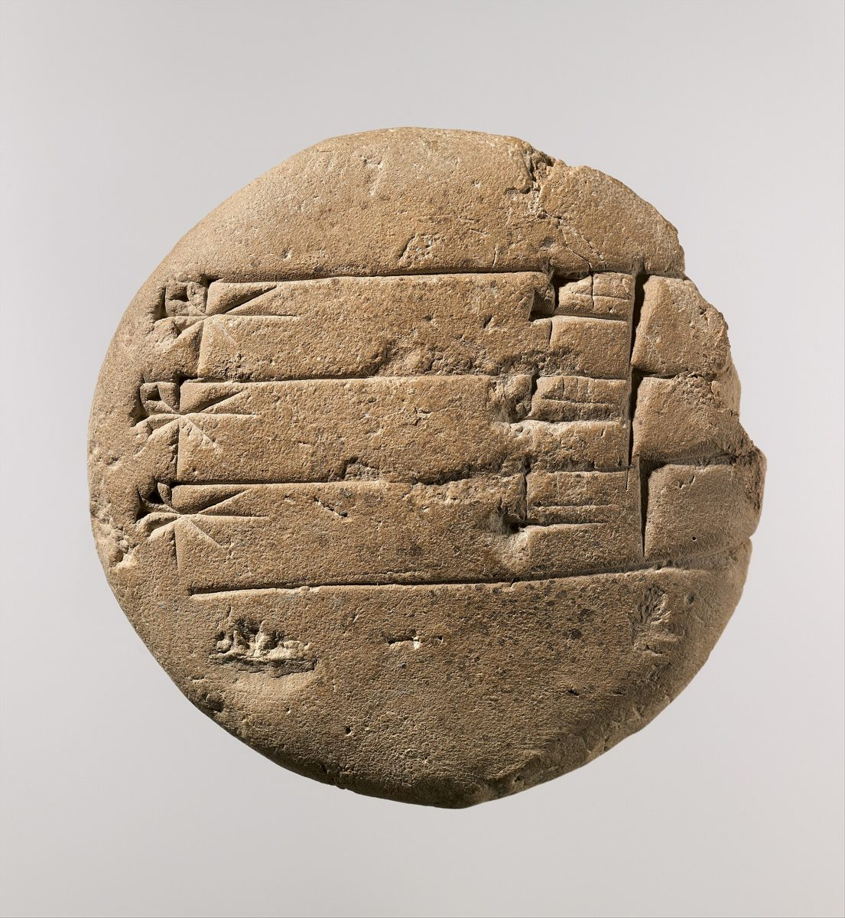

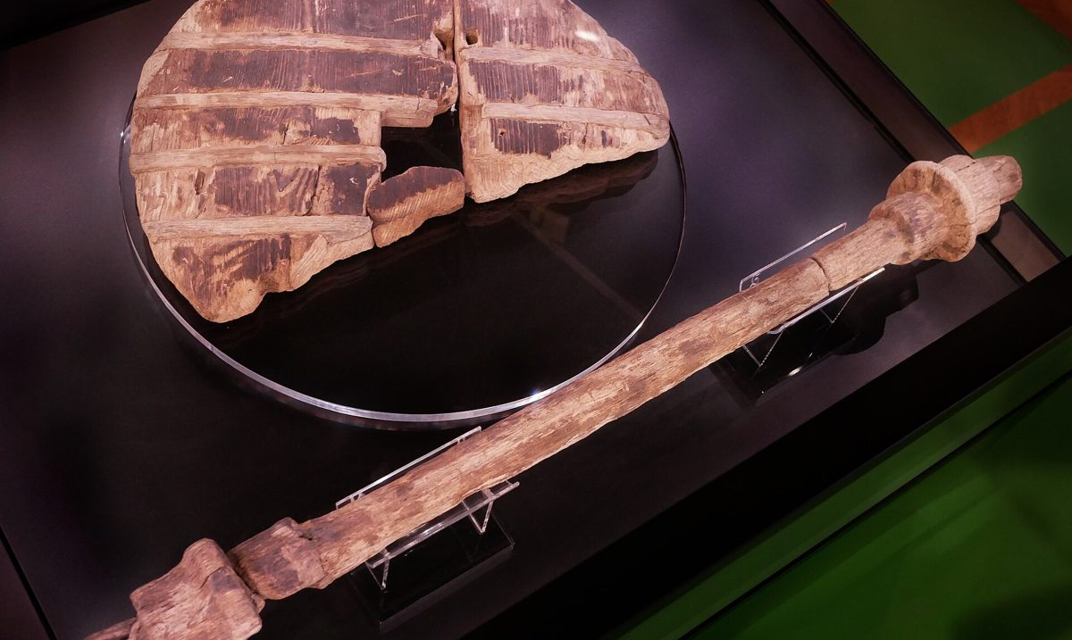
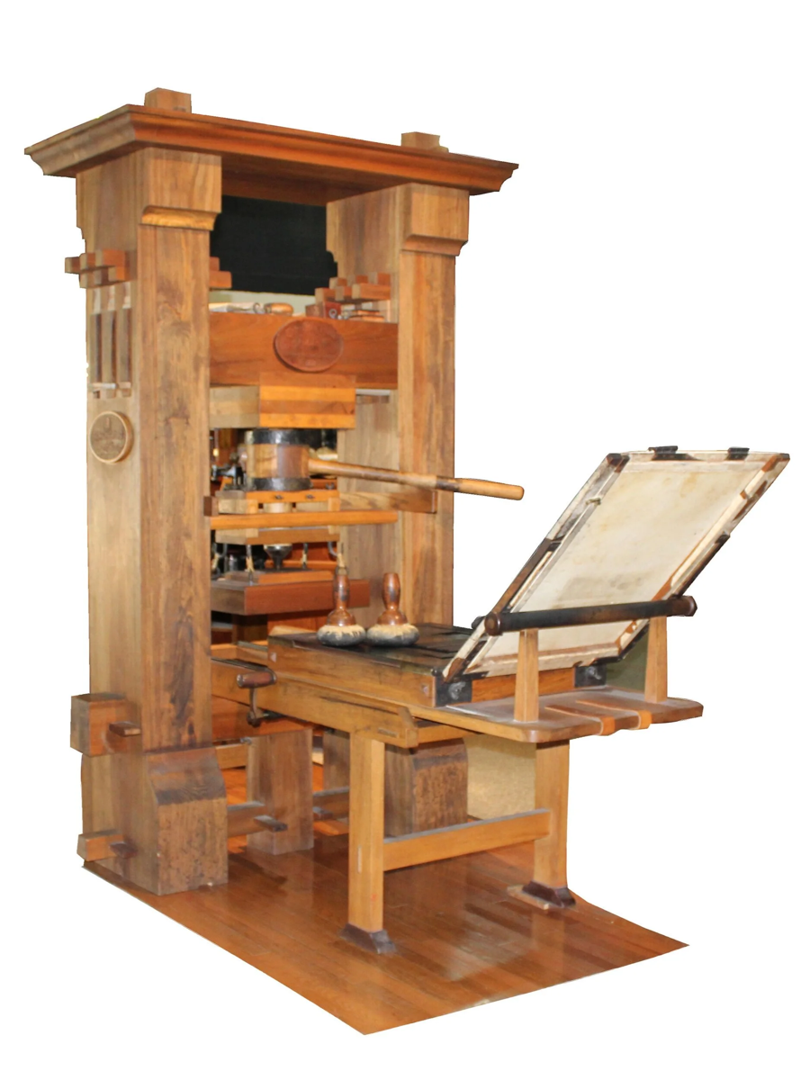
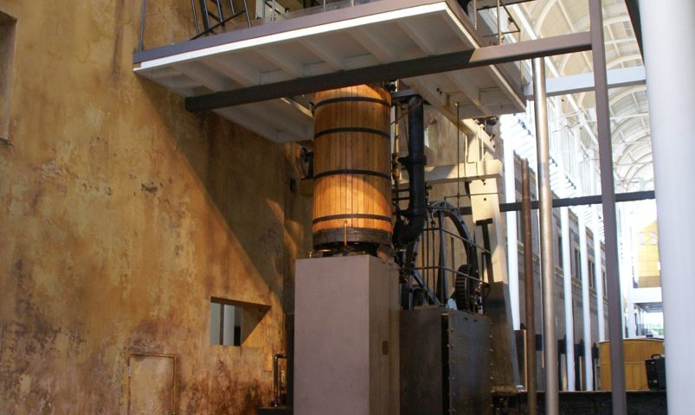
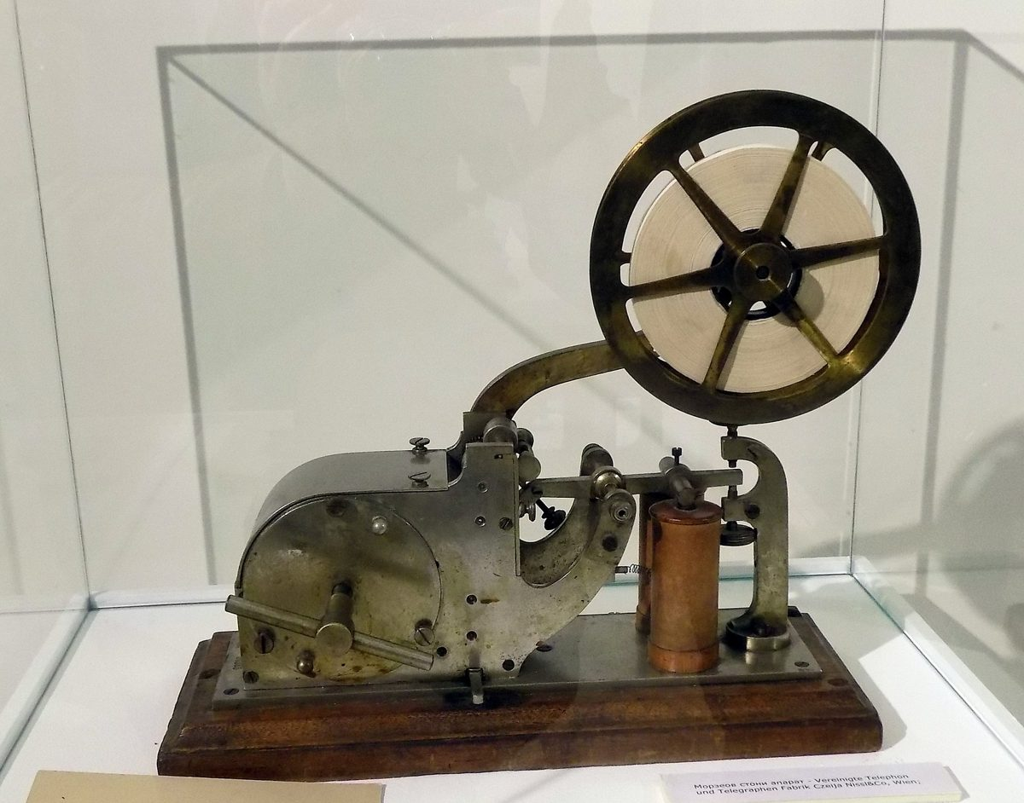
From Computation to Language Models
Humans stand out among all other in one respect above all:
we build tools that make our lives better.
we pass those tools on.
control of fire
writing
This is taken even further by the ability to transform information: Computation.
the wheel
printing
steam power
the telegraph
Physical
Informational

Slide 4
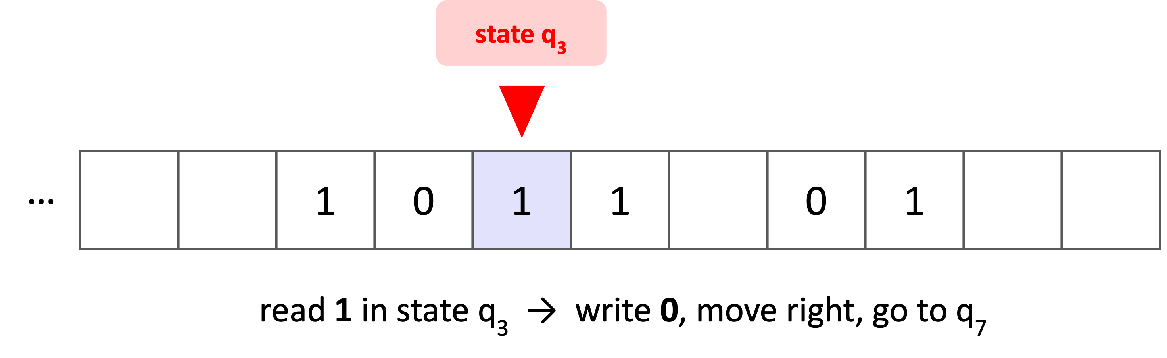
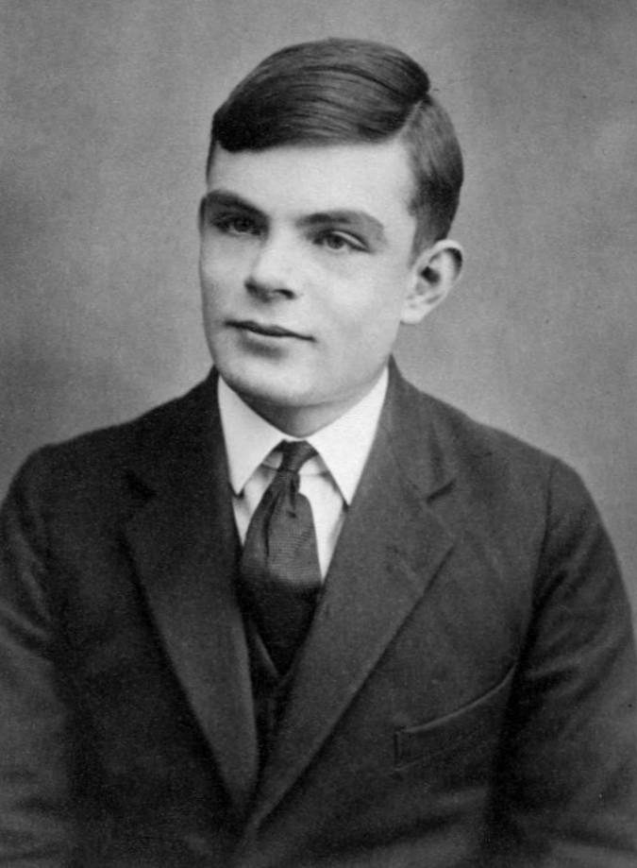
From Computation to Language Models
This is taken even further by the ability to transform information: Computation.
1936: computation becomes a mathematical object
Alan Turing
A finite table of rules, reading and writing symbols on a tape, captures what it means to compute; one universal machine can run any other.

Slide 5

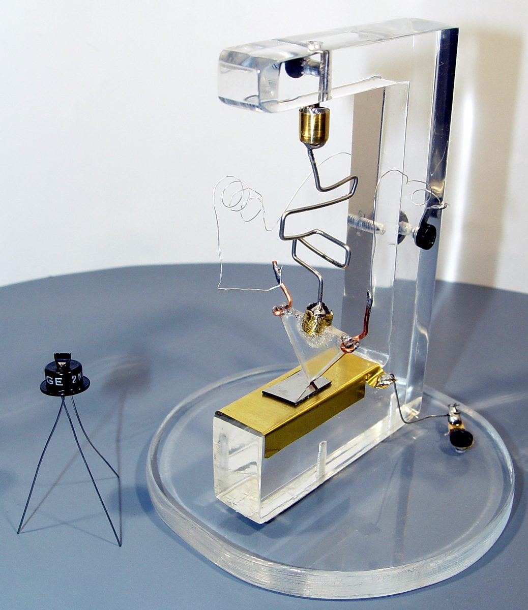
From Computation to Language Models
This is taken even further by the ability to transform information: Computation.
1936: computation becomes a mathematical object
1946–1947: computers become physical objects
ENIAC, announced 1946
ENIAC: about 18,000 vacuum tubes, reprogrammed by rewiring. The transistor (Bell Labs, 1947) made computers small, cheap, and reliable.
the first transistor (replica), 1947

Slide 6



From Computation to Language Models
This is taken even further by the ability to transform information: Computation.
1936: computation becomes a mathematical object
hidden
typed questions
A: a person
1946–1947: computers become physical objects
1950: the imitation game
interrogator
B: a machine
Which one is the machine?
Typed conversation only. If the interrogator cannot reliably tell which is the machine, the machine passes.
Notes:
1950. Turing's imitation game: an interrogator converses by typed questions with a hidden person and a hidden machine and must say which is the machine. Icons: react-icons (Font Awesome), drawn for the course.

Slide 7
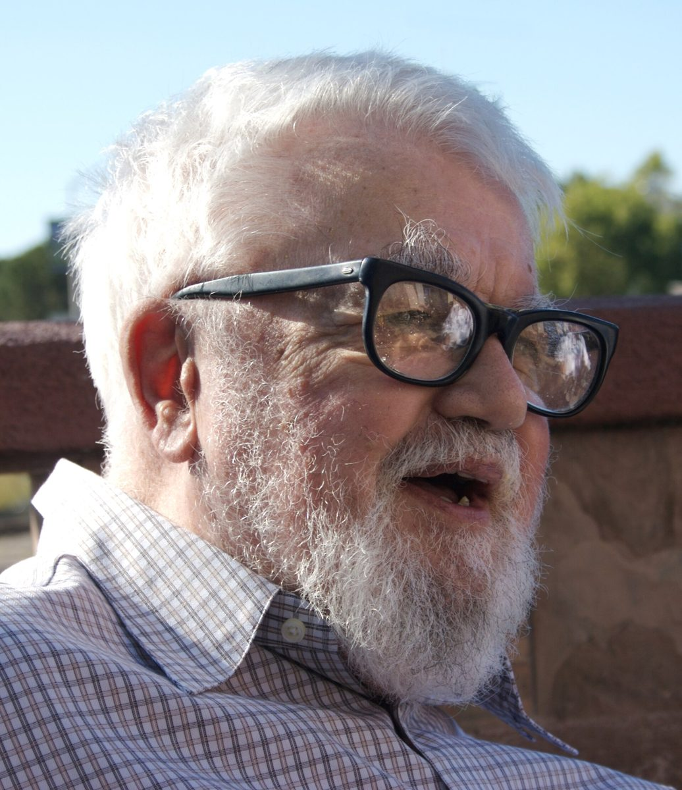
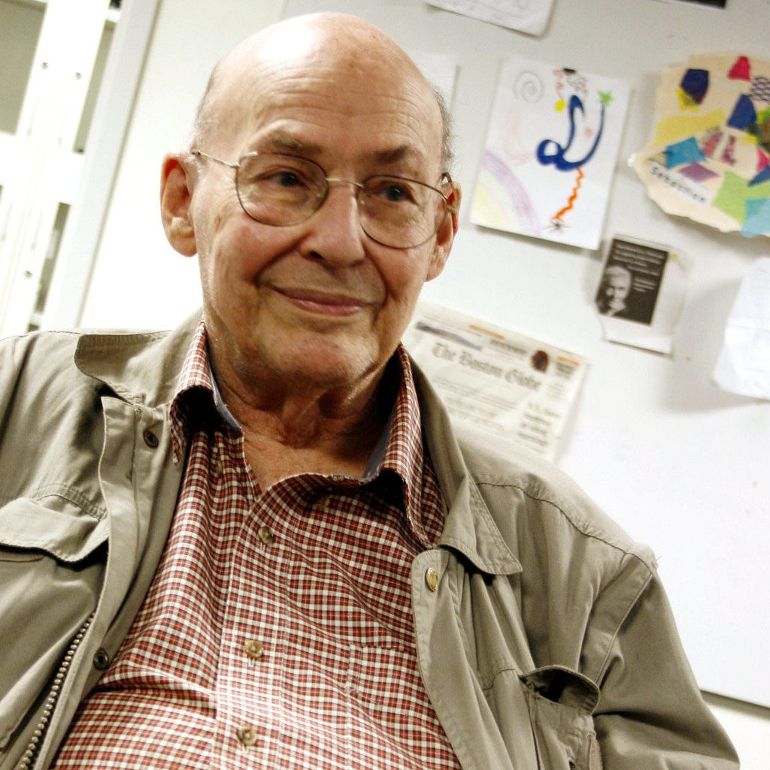
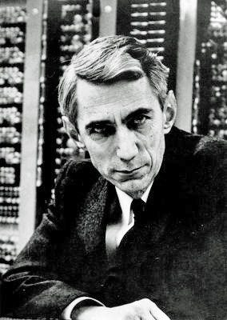
From Computation to Language Models
This is taken even further by the ability to transform information: Computation.
“Every aspect of learning or any other feature of intelligence can in principle be so precisely described that a machine can be made to simulate it.”
the Dartmouth proposal, 1955
1936: computation becomes a mathematical object
1946–1947: computers become physical objects
1950: the imitation game
1955–1956: artificial intelligence gets a name
Marvin Minsky
John McCarthy
Claude Shannon
with Nathaniel Rochester of IBM, the fourth author
The proposal (August 1955) coined the name “artificial intelligence”; the summer workshop of 1956 started the field.
Notes:
1955-1956. The proposal (August 1955) named the field and made the conjecture quoted; the workshop was held in the summer of 1956. Photos, Wikimedia Commons: John McCarthy Stanford.jpg (null0, CC BY-SA 2.0); Marvin Minsky at OLPCb.jpg (Sethwoodworth, CC BY 3.0); ClaudeShannon MFO3807.jpg (Konrad Jacobs, CC BY-SA 2.0 de). No freely licensed photo of Nathaniel Rochester was found.

Slide 8
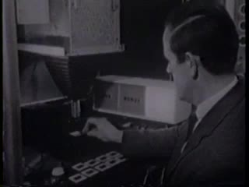
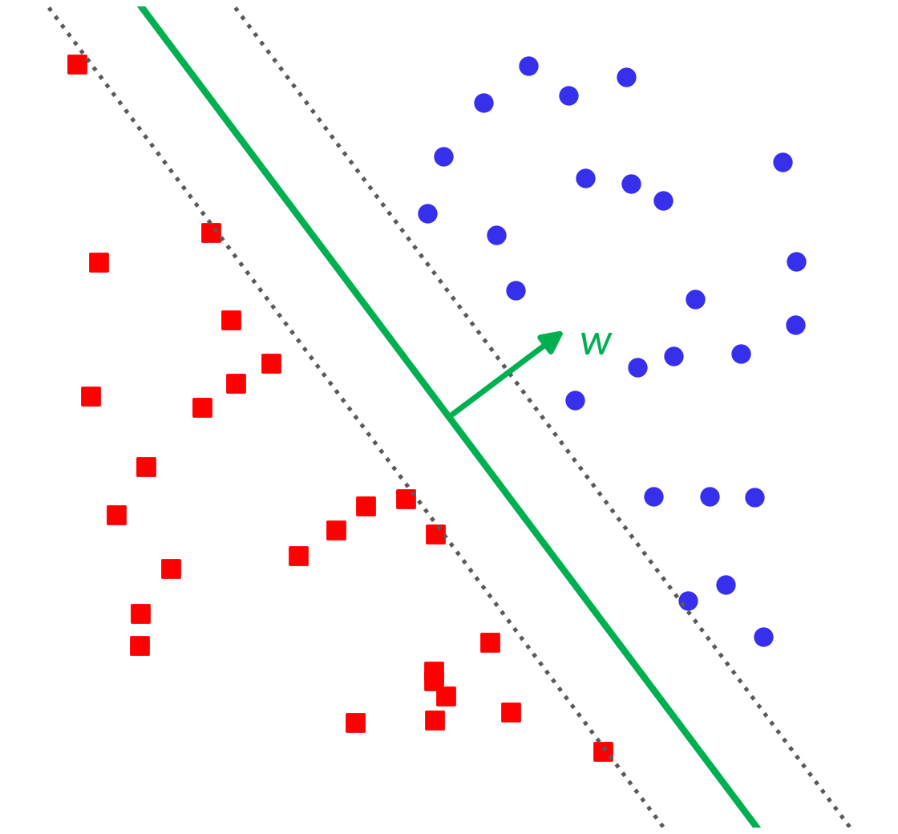
From Computation to Language Models
This is taken even further by the ability to transform information: Computation.
1936: computation becomes a mathematical object
1946–1947: computers become physical objects
1950: the imitation game
1955–1956: artificial intelligence gets a name
1958: the perceptron learns from examples
ML
The Mark I Perceptron at work (film clip)
Rosenblatt's perceptron nudges its weights after each mistake, until a line separates the two classes: an early landmark of machine learning.
Notes:
1958. Click the film to play it (71 s, the Internet Archive's perceptron_documentary_excerpt). Rosenblatt's perceptron learns a separating line from labeled examples: an early landmark of machine learning (tag ML).

Slide 9
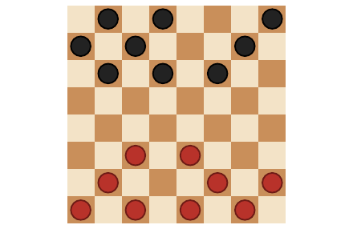
From Computation to Language Models
This is taken even further by the ability to transform information: Computation.
1936: computation becomes a mathematical object
1946–1947: computers become physical objects
1950: the imitation game
1955–1956: artificial intelligence gets a name
1958: the perceptron learns from examples
ML
play against a copy of itself
look ahead: a better estimate of the position
move the evaluation toward that estimate
1959: Samuel's checkers player learns from self-play
RL
repeat, game after game
Arthur Samuel's program played checkers against itself and moved its evaluation of positions toward what looking ahead revealed: an early landmark of reinforcement learning. His paper's title is an early use of the phrase “machine learning”.
Notes:
1959. Arthur Samuel, 'Some Studies in Machine Learning Using the Game of Checkers' (IBM Journal of Research and Development, 1959). The program played against a copy of itself and adjusted the coefficients of its evaluation function so that the value of a position moved toward the value found by searching ahead: an ancestor of temporal-difference learning (Sutton and Barto, Reinforcement Learning, 2nd ed., §16.2). Tag RL: an early landmark of reinforcement learning. Board drawn for the course; no freely licensed photo of Samuel was found.

Slide 10
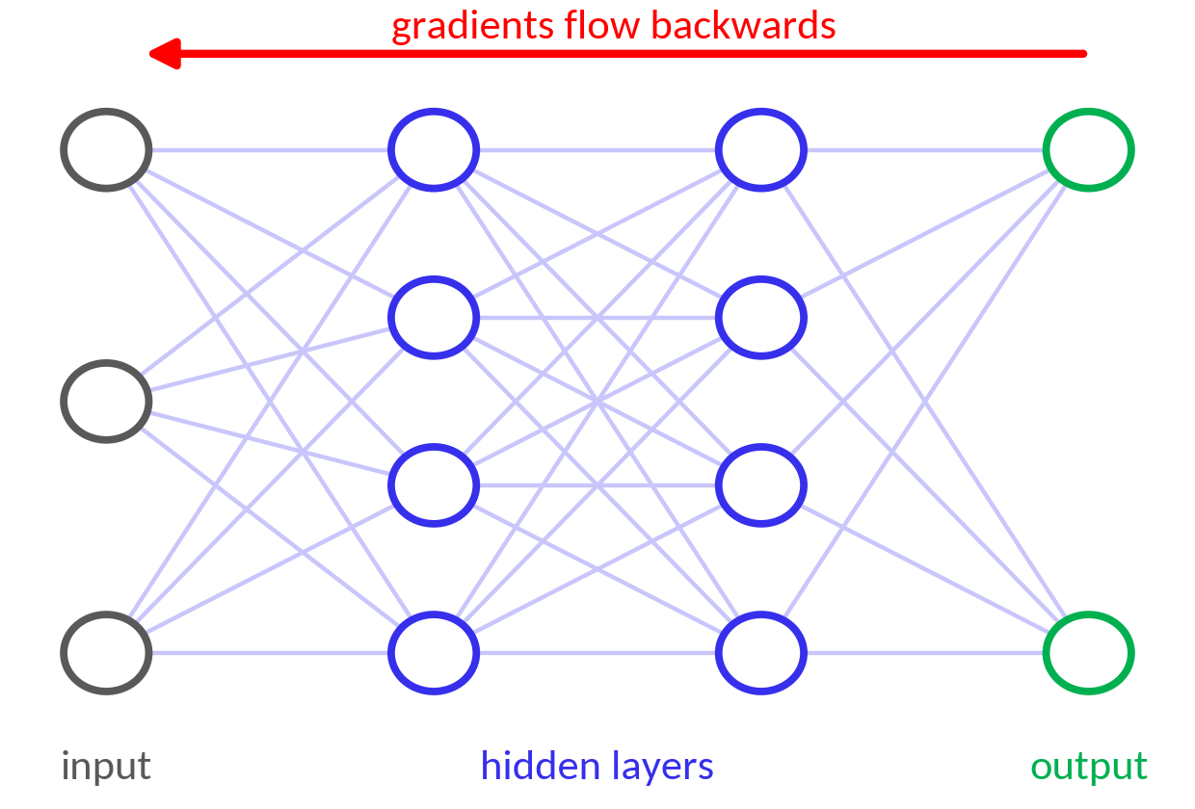
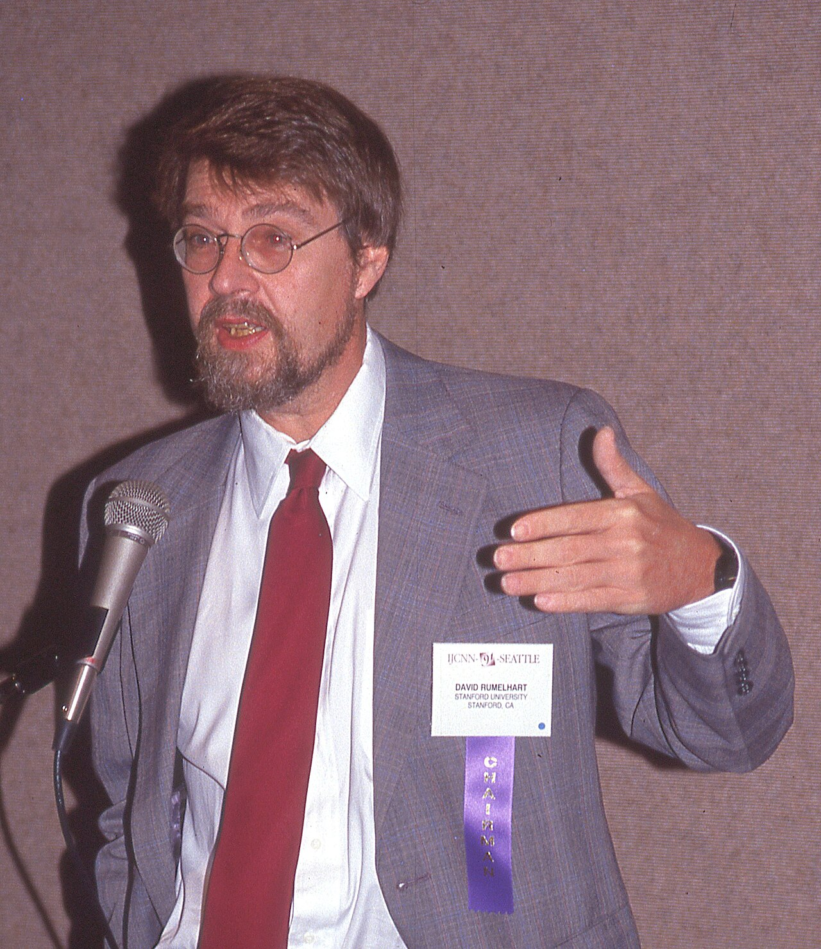
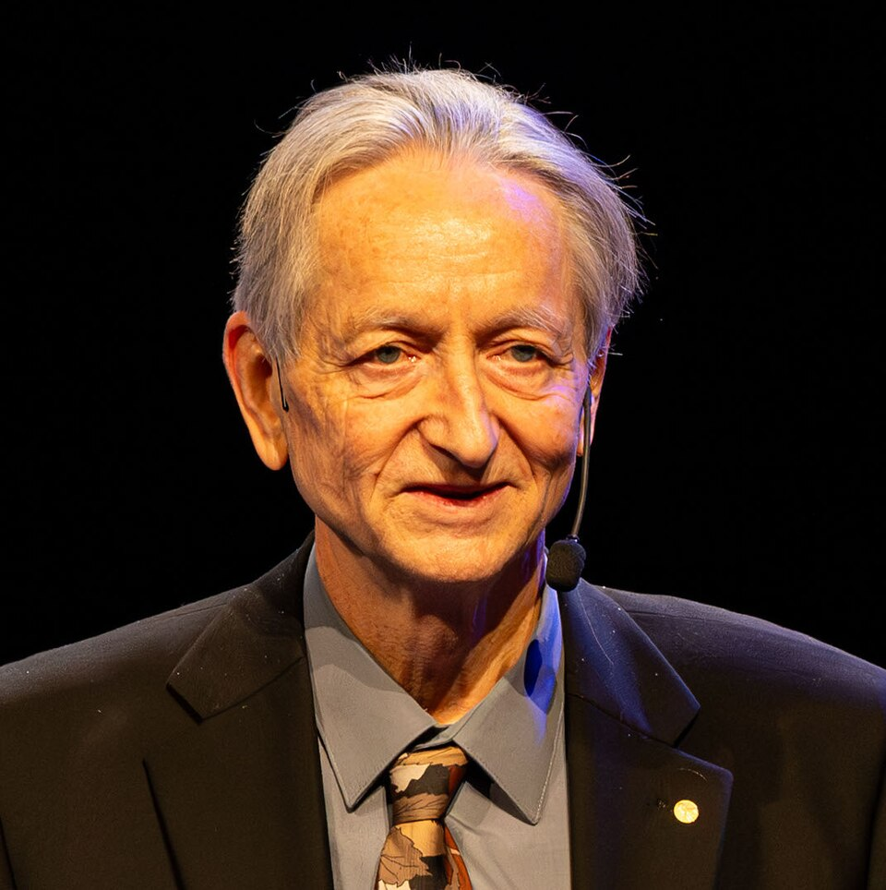
From Computation to Language Models
This is taken even further by the ability to transform information: Computation.
1936: computation becomes a mathematical object
1946–1947: computers become physical objects
1950: the imitation game
1955–1956: artificial intelligence gets a name
1958: the perceptron learns from examples
ML
1959: Samuel's checkers player learns from self-play
RL
The chain rule, run backwards, gives every weight's gradient in one pass, so hidden layers learn their own features: an early landmark of deep learning.
1986: networks learn their own features
DL
David Rumelhart
Geoffrey Hinton
Notes:
1986. Rumelhart, Hinton, and Williams popularized backpropagation for networks with hidden layers (no freely licensed photo of Ronald Williams was found). Photos, Wikimedia Commons: DavidRumelhart-IJCNNseattle1991-07-08.jpg (Rolf Kickuth, CC BY-SA 4.0); Geoffrey E. Hinton, 2024 Nobel Prize Laureate in Physics (cropped1).jpg (Arthur Petron, CC BY-SA 4.0).

Slide 11
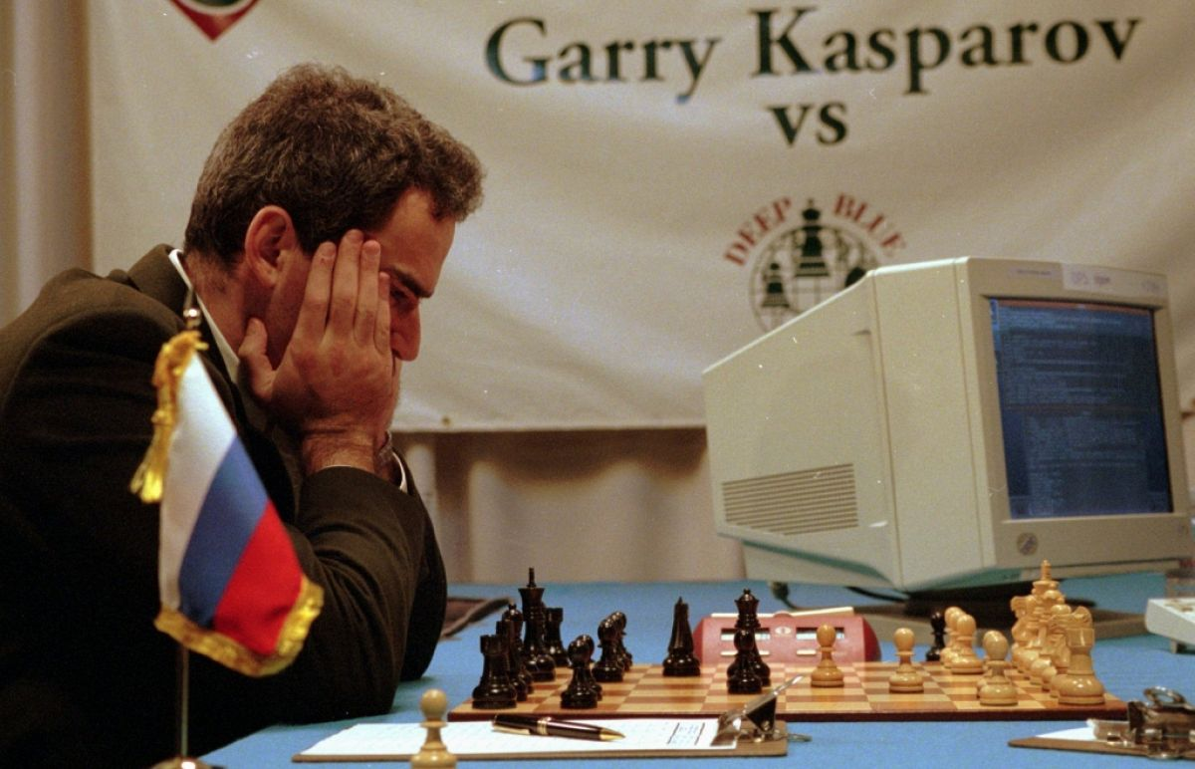
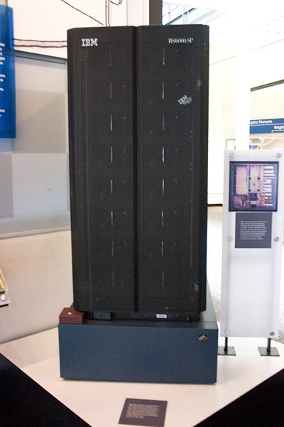
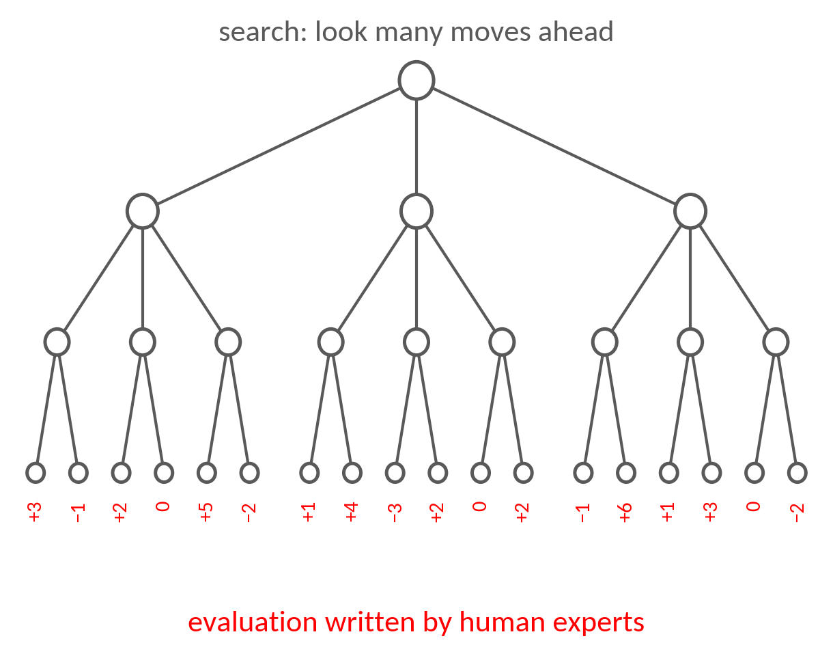
From Computation to Language Models
This is taken even further by the ability to transform information: Computation.
1936: computation becomes a mathematical object
1946–1947: computers become physical objects
1950: the imitation game
1955–1956: artificial intelligence gets a name
Kasparov against Deep Blue, 1996
Deep Blue
1958: the perceptron learns from examples
ML
1959: Samuel's checkers player learns from self-play
Deep Blue searched up to 200 million positions a second and scored them with an evaluation function written by chess experts: a landmark of classical, search-based AI.
RL
1986: networks learn their own features
DL
1997: Deep Blue defeats Kasparov
AI
Notes:
1997. Deep Blue beat Kasparov 3.5-2.5: deep search of the game tree with an evaluation function written by human experts, on custom chips. Photos: Kasparov at the 1996 match in Philadelphia (RTVE, as in Foundations 1 of the Background Notes); Deep Blue.jpg (James the photographer, CC BY 2.0, Wikimedia Commons).

Slide 12
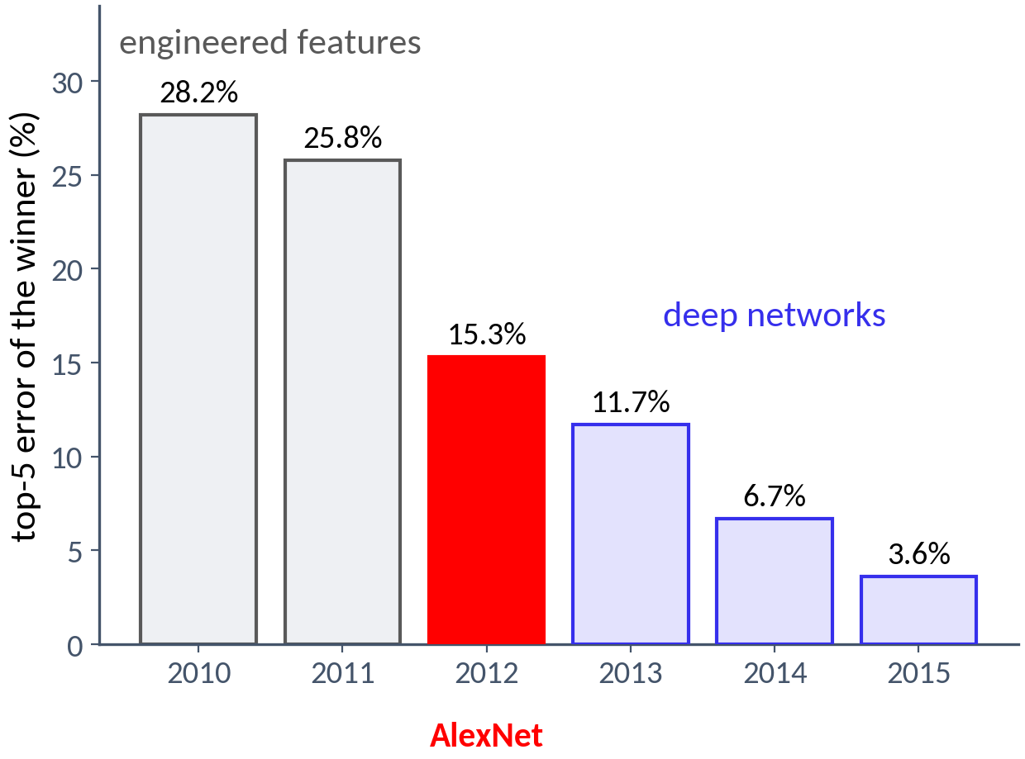
From Computation to Language Models
This is taken even further by the ability to transform information: Computation.
1936: computation becomes a mathematical object
1946–1947: computers become physical objects
1950: the imitation game
1955–1956: artificial intelligence gets a name
1958: the perceptron learns from examples
ML
1959: Samuel's checkers player learns from self-play
RL
1986: networks learn their own features
DL
1997: Deep Blue defeats Kasparov
AI
2012: AlexNet wins ImageNet
ImageNet: 1.2 million labeled photos in 1,000 classes. AlexNet, a deep convolutional network trained on two GPUs, learned its own features and cut the winning error from 25.8% to 15.3%.
Notes:
2012. AlexNet cut the ImageNet top-5 error from 25.8% to 15.3%: features learned from 1.2 million labeled images on GPUs replaced features designed by hand.

Slide 13
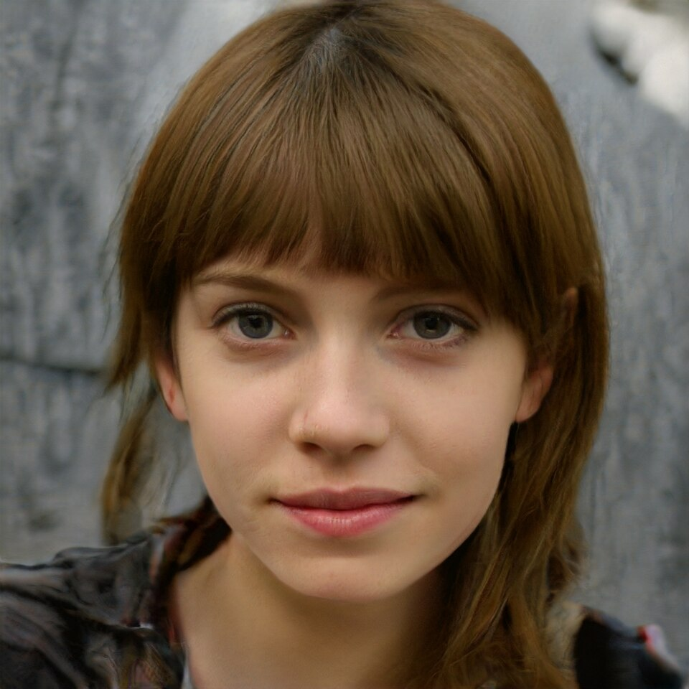

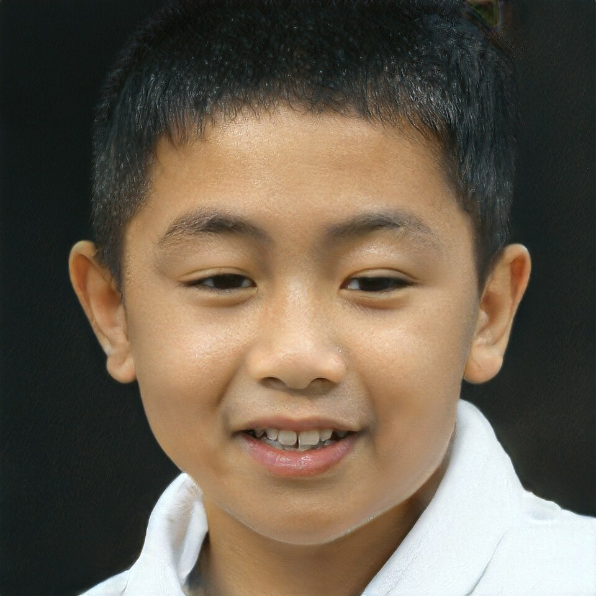
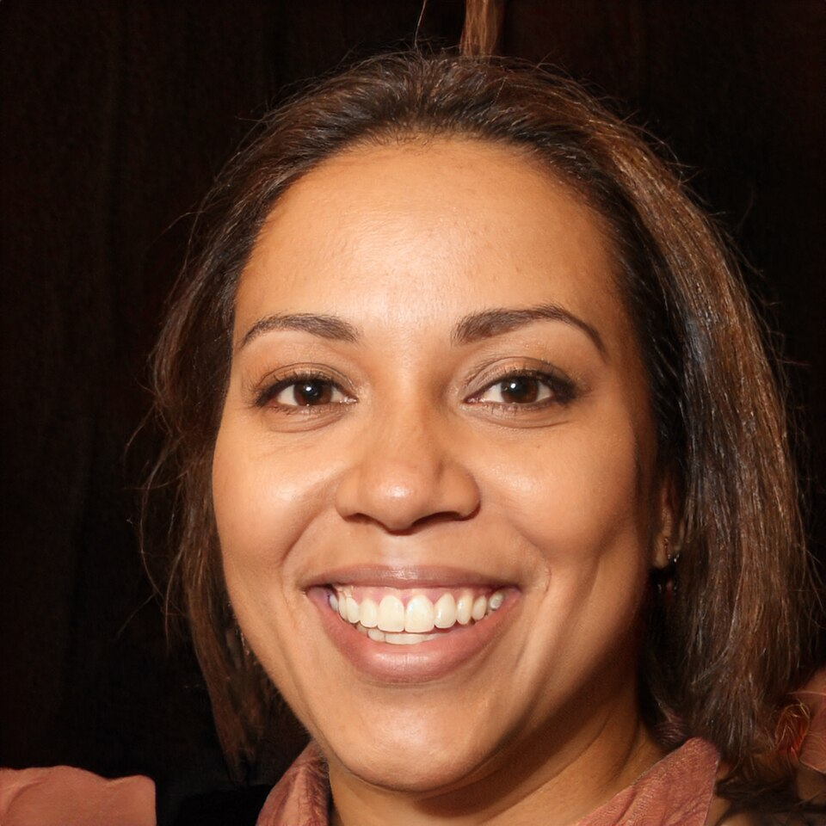

From Computation to Language Models
This is taken even further by the ability to transform information: Computation.
noise
generator
fake image
1936: computation becomes a mathematical object
discriminator
1946–1947: computers become physical objects
1950: the imitation game
real or fake?
real image
1955–1956: artificial intelligence gets a name
1958: the perceptron learns from examples
ML
1959: Samuel's checkers player learns from self-play
RL
1986: networks learn their own features
DL
none of these people exist (StyleGAN, 2019–2020)
Ian Goodfellow
1997: Deep Blue defeats Kasparov
AI
2012: AlexNet wins ImageNet
A generator turns random noise into images while a discriminator learns to tell them from real ones; each improves against the other (Goodfellow et al., 2014). The faces come from a later descendant.
2014: generation before ChatGPT
Notes:
2014. Generative adversarial networks (Goodfellow et al.): a generator learns to produce images and a discriminator learns to tell real from fake; generation predates ChatGPT. The 2014 samples were small digits and blurry faces; the faces shown come from StyleGAN models (2019-2020). Images, Wikimedia Commons, public domain: Woman 1.jpg, Man 2.jpg, Boy 1.jpg (Owlsmcgee); This Person Does Not Exist example.jpg. Photo: Ian Goodfellow (cropped).jpg (Ian Goodfellow, CC BY-SA 4.0).

Slide 14
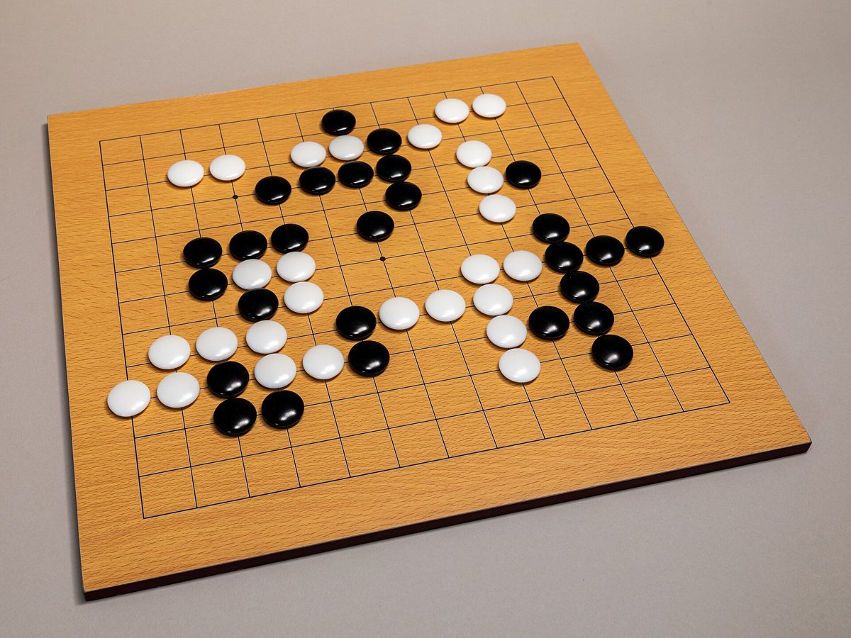
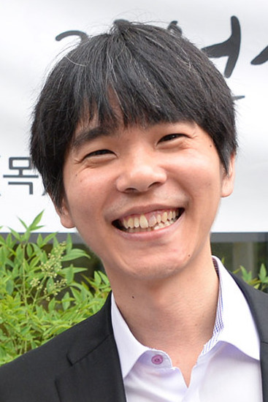
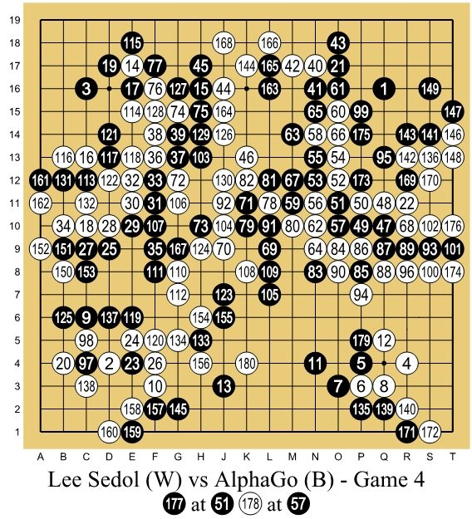
From Computation to Language Models
This is taken even further by the ability to transform information: Computation.
1936: computation becomes a mathematical object
1946–1947: computers become physical objects
1950: the imitation game
1955–1956: artificial intelligence gets a name
1958: the perceptron learns from examples
ML
a game of Go
Lee Sedol
1959: Samuel's checkers player learns from self-play
RL
1986: networks learn their own features
Networks learned from expert games and from self-play which moves to consider and who is winning; a tree search combined them. AlphaGo won the match 4–1.
DL
1997: Deep Blue defeats Kasparov
AI
2012: AlexNet wins ImageNet
2014: generation before ChatGPT
2016: AlphaGo defeats Lee Sedol, 4–1
Notes:
2016. AlphaGo beat Lee Sedol 4-1: networks learned from expert games and self-play which moves to explore and who is winning, and a tree search combined the two. Lee won Game 4 with his move 78. No freely licensed photograph of the match itself was found; the well-known one of Lee at the board belongs to Google DeepMind. Wikimedia Commons: Go (13x13) -- 2021 -- 6741.jpg (Dietmar Rabich, CC BY-SA 4.0); Lee Se-Dol - 2016 (cropped).jpg (LG Electronics, CC BY 2.0).

Slide 15
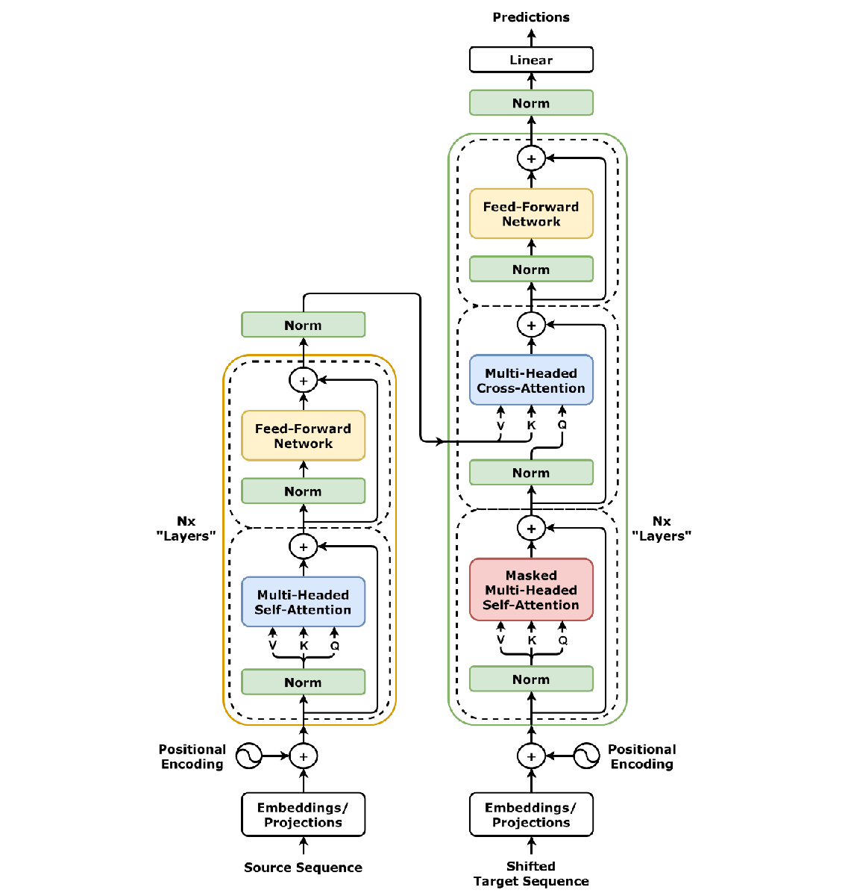
From Computation to Language Models
This is taken even further by the ability to transform information: Computation.
Language Models
2017: the Transformer
Designed for machine translation: the encoder (left) reads a sentence and the decoder (right) writes its translation. Every position reads from the others through attention. The decoder alone, trained to predict the next token, is a language model; we build one in Week 4.
Notes:
2017. The Transformer (Vaswani et al., 'Attention Is All You Need'): attention lets each position read directly from other positions, with the same parameters at every position. Built for translation as an encoder-decoder; the decoder alone, trained on next-token prediction, became the basis of language models. Figure: Transformer, full architecture.png (dvgodoy, CC BY 4.0, Wikimedia Commons).

Slide 16
From Computation to Language Models
This is taken even further by the ability to transform information: Computation.
unlabeled text: books and web pages
Language Models
pretrain: predict the next word (GPT)
or hidden words (BERT)
2017: the Transformer
one pretrained Transformer
2018: GPT and BERT: pretrain, then fine-tune
sentiment
question answering
entailment
fine-tune a copy for each task, with a small labeled set
Pretraining on unlabeled text gives one network that already knows much about language; fine-tuning a copy on each task beat models built for that task alone. GPT reads left to right; BERT reads in both directions.
Notes:
2018. GPT (Radford et al.) and BERT (Devlin et al.): a Transformer pretrained on unlabeled text, then fine-tuned for each task, beat models built for individual tasks. GPT predicts the next word; BERT predicts masked words from both sides. Diagram drawn for the course.

Slide 17
From Computation to Language Models
This is taken even further by the ability to transform information: Computation.
prompt
Review: The plot dragged; the end made no sense.
Sentiment: negative
Review: A warm, funny film with a great cast.
Sentiment: positive
Review: I'd happily watch it again tomorrow.
Sentiment:
Language Models
2017: the Transformer
2018: GPT and BERT: pretrain, then fine-tune
2020: GPT-3: a task from a few examples
the model continues: positive
GPT-3 has 175 billion parameters. The task is given in the prompt by a few examples, and nothing is retrained: the weights stay fixed. Ask the room what comes next, then reveal.
Notes:
2020. GPT-3 (Brown et al.): a 175-billion-parameter model performs new tasks from a prompt containing a few examples (in-context learning), with its weights held fixed. Week 5 returns to prompting and in-context learning. The example was written for the course.

Slide 18
From Computation to Language Models
This is taken even further by the ability to transform information: Computation.
Write a Python function that returns
the n-th Fibonacci number.
Language Models
def fib(n):
return n if n < 2 else fib(n-1) + fib(n-2)
2017: the Transformer
2018: GPT and BERT: pretrain, then fine-tune
It is slow for n = 40. Make it fast.
2020: GPT-3: a task from a few examples
2022: ChatGPT: an assistant you can talk to
def fib(n):
a, b = 0, 1
for _ in range(n):
a, b = b, a + b
return a
an illustrative exchange
Post-training on demonstrations and human preferences, plus a chat interface, turned a language model into an assistant that follows instructions (announced 30 November 2022).
Notes:
2022. ChatGPT (OpenAI, 30 November 2022): supervised fine-tuning on demonstrations and reinforcement learning from human preferences, with a conversational interface, made a language model usable as an assistant. Week 7 builds this. The exchange is illustrative, written for the course; replace it with a recorded one if you prefer (system, version, date).

Slide 19

From Computation to Language Models
This is taken even further by the ability to transform information: Computation.
Language Models
2017: the Transformer
2018: GPT and BERT: pretrain, then fine-tune
2020: GPT-3: a task from a few examples
2022: ChatGPT: an assistant you can talk to
What flower is this?
2023–2024: GPT-4 and GPT-4o: images and audio in
An iris: most likely Iris versicolor,
the blue flag.
an illustrative exchange
GPT-4 (2023) accepted images as well as text; GPT-4o (2024) took text, audio, and images in one model. The same flower returns in the terminology.
Notes:
2023 and 2024. GPT-4 (OpenAI, March 2023): images as input. GPT-4o (May 2024): one model for text, audio, and images. The exchange is illustrative. Photo: Verschiedenfarbige Schwertlilie (Iris versicolor)-20200603-RM-100257.jpg (Ermell, CC BY-SA 4.0, Wikimedia Commons).

Slide 20
From Computation to Language Models
This is taken even further by the ability to transform information: Computation.
Find all x in {0, 1, …, 34} with x² ≡ 1 (mod 35).
Language Models
thinking …
35 = 5 · 7, so x² ≡ 1 modulo 5 and modulo 7.
x ≡ ±1 (mod 5) and x ≡ ±1 (mod 7): four cases.
Combine them: 1, 6, 29, 34. Check: 6² = 36 = 35 + 1.
2017: the Transformer
2018: GPT and BERT: pretrain, then fine-tune
2020: GPT-3: a task from a few examples
2022: ChatGPT: an assistant you can talk to
answer: 1, 6, 29, 34
checked ✓ → reward
2023–2024: GPT-4 and GPT-4o: images and audio in
reinforcement learning on many such problems updates the model
2024–2025: o1 and R1: reasoning before answering
Rewarding answers that check out taught models to think at length before answering (OpenAI o1, 2024; DeepSeek-R1, 2025): more computation at inference, more answers right.
Notes:
2024 and 2025. OpenAI o1 (September 2024) and DeepSeek-R1 (January 2025): reinforcement learning on problems with checkable answers taught models to reason at length before answering, spending more computation at inference time to get more answers right. Weeks 6 to 8. The problem was written for the course; the answer is correct (6^2 = 36, 29^2 = 841 = 24*35 + 1, 34^2 = 1156 = 33*35 + 1).

Slide 21

From Computation to Language Models
This is taken even further by the ability to transform information: Computation.
35/42
Language Models
2017: the Transformer
2018: GPT and BERT: pretrain, then fine-tune
P1
✓
P2
✓
P3
✓
P4
✓
P5
✓
P6
✗
2020: GPT-3: a task from a few examples
2022: ChatGPT: an assistant you can talk to
5 of 6 problems, 7 points each; the gold cutoff was 35
2023–2024: GPT-4 and GPT-4o: images and audio in
An advanced version of Gemini Deep Think wrote natural-language proofs within the 4.5-hour limit, graded by the IMO coordinators (July 2025).
2024–2025: o1 and R1: reasoning before answering
2025: gold-medal standard at the IMO
Gemini Deep Think at gold-medal level: the post on r/singularity
Notes:
2025. International Mathematical Olympiad: an advanced version of Gemini Deep Think solved five of the six problems, for 35 of 42 points, graded by the competition's coordinators, end to end in natural language within the time limit (Google DeepMind, July 2025). IMO logo: IMO logo.svg (International Mathematical Olympiad, public domain, Wikimedia Commons). Link: https://www.reddit.com/r/singularity/comments/1m5o1ll/gemini_with_deep_think_achieves_gold_medallevel/

Slide 22
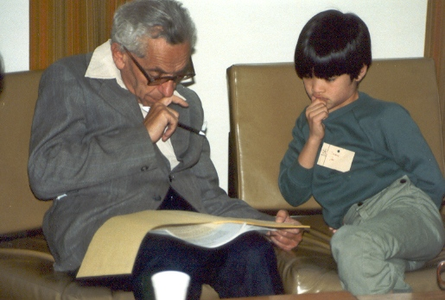
From Computation to Language Models
This is taken even further by the ability to transform information: Computation.
Language Models
2017: the Transformer
2018: GPT and BERT: pretrain, then fine-tune
2020: GPT-3: a task from a few examples
2022: ChatGPT: an assistant you can talk to
2023–2024: GPT-4 and GPT-4o: images and audio in
Paul Erdős with a young Terence Tao
2024–2025: o1 and R1: reasoning before answering
Erdős left over a thousand problems. Language models, sometimes with the Lean proof assistant, began resolving them; Problem 728 was settled in January 2026 with a Lean-checked proof. Tao's tracker records each contribution, from finding the literature to full solutions, and cautions that some problems had simply been overlooked.
2025: gold-medal standard at the IMO
2025–2026: open Erdős problems resolved
Notes:
2025 and 2026. Open Erdős problems: see Terence Tao's wiki 'AI contributions to Erdős problems' (github.com/teorth/erdosproblems) and arXiv:2601.07421 for Problem 728. Photo: Paul Erdos with Terence Tao.jpg (Billy or Grace Tao, CC BY-SA 2.0, Wikimedia Commons).

Slide 23
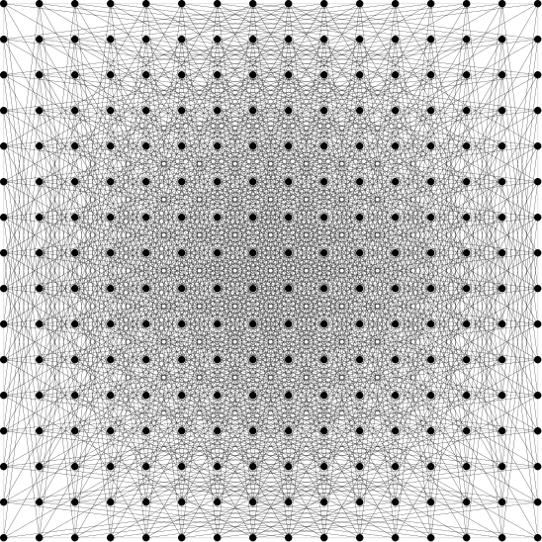
From Computation to Language Models
This is taken even further by the ability to transform information: Computation.
Language Models
2017: the Transformer
2018: GPT and BERT: pretrain, then fine-tune
2020: GPT-3: a task from a few examples
2022: ChatGPT: an assistant you can talk to
2023–2024: GPT-4 and GPT-4o: images and audio in
a rescaled square grid: the old record, now beaten
2024–2025: o1 and R1: reasoning before answering
2025: gold-medal standard at the IMO
An internal OpenAI reasoning model built point sets with far more unit distances than Erdős believed possible, using algebraic number theory. Noga Alon, Tim Gowers, and others checked it and wrote a companion paper (May 2026).
2025–2026: open Erdős problems resolved
2026: the unit distance conjecture disproved
Notes:
2026. Erdős conjectured in 1946 that n points in the plane determine at most n^(1+o(1)) pairs at distance exactly one (u(n) on the slide). In May 2026 an internal OpenAI reasoning model constructed configurations with at least n^(1+delta) such pairs, for a fixed delta > 0. Picture: OpenAI, from its announcement 'Model disproves discrete geometry conjecture'; companion paper arXiv:2605.20695.

Slide 24
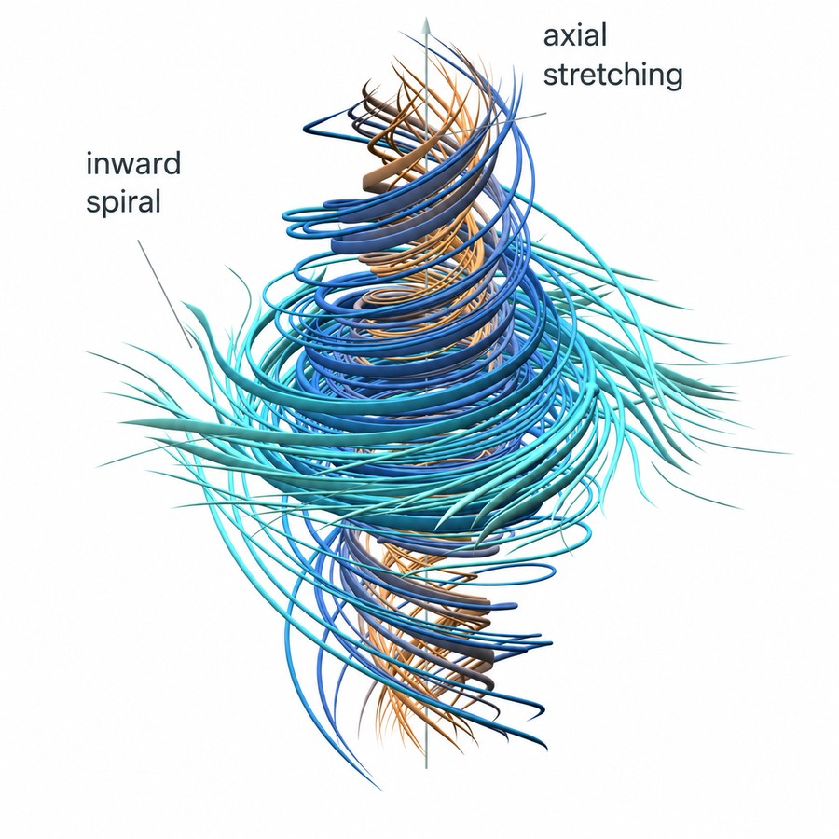
From Computation to Language Models
This is taken even further by the ability to transform information: Computation.
Language Models
2017: the Transformer
2018: GPT and BERT: pretrain, then fine-tune
2020: GPT-3: a task from a few examples
2022: ChatGPT: an assistant you can talk to
2023–2024: GPT-4 and GPT-4o: images and audio in
a swirling flow, spiraling inward and stretching along its axis
2024–2025: o1 and R1: reasoning before answering
About 10,000 coordinated agents produced a Lean-checked proof that a fluid at rest, driven by a smooth force, can blow up in finite time in 3D. The Clay Institute says the problem “has apparently been settled” and is reviewing; priority and the role of the forcing are debated.
2025: gold-medal standard at the IMO
2025–2026: open Erdős problems resolved
2026: the unit distance conjecture disproved
2026: Navier–Stokes blowup, claimed
Notes:
2026, claimed. In September 2026 OpenAI announced finite-time singularity for the forced three-dimensional Navier-Stokes equations (one of the outcomes the Clay problem allows), checked in Lean. The Clay Mathematics Institute began a deliberately unhurried review. Read the claim with its evidence: a formal proof, expert checking, a review still under way. Picture: OpenAI, from its announcement.

Slide 25
Lecture 1: (Artificial) Intelligence, Learning, Language, and Meaning
Short timeline highlighting language and its modeling, course description: what we will study and build
Basic AI/ML/DL terminology
Understanding
  Intelligence
  Learning
  Language
  Meaning
Hands-on: an autograd engine
Notes:
Next: what we will study and build.

Slide 26
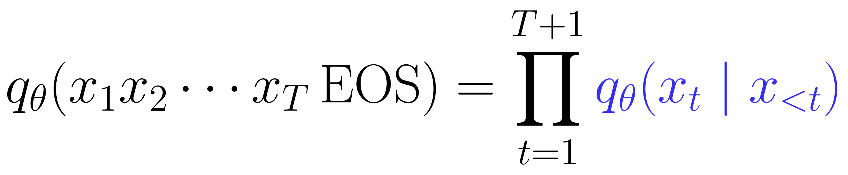
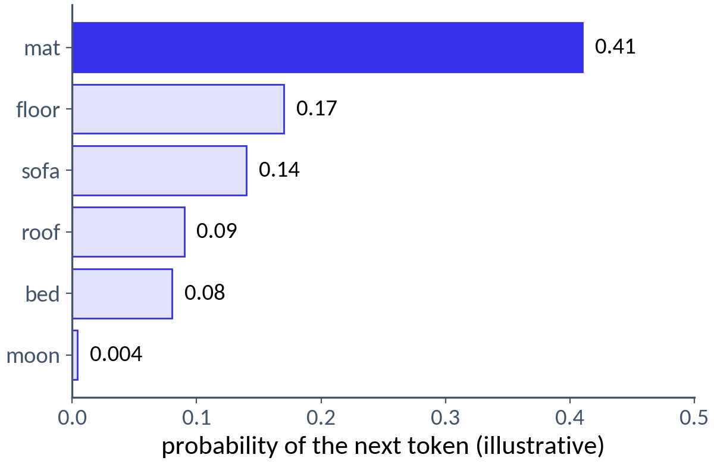
The Language Model
A language model is a generative model of text: a probability distribution over strings of tokens (characters, words, or pieces of words).
It predicts one token at a time: each factor is a distribution over the vocabulary, given everything before it.
To generate text: sample a token, append it, repeat.
Not a new idea. The product is the chain rule of probability, and Shannon generated English this way in 1948.
The main innovation is how each conditional is computed and fitted.
the cat sat on the ___
Notes:
The object at the center of the course: a probability distribution over strings, computed one token at a time. q_theta(x_1...x_T EOS) = prod_t q_theta(x_t | x_<t), with x_{T+1} = EOS. The chain rule is not new, and Shannon (1948) generated English from such conditionals. What is new is how the conditionals are computed and fitted: a neural network maps the whole prefix to a distribution over the next token (the Transformer), trained at scale, then post-trained. The probabilities in the chart are illustrative.

Slide 27
Course Plan
week
lecture
we build
Week 1
(Artificial) Intelligence, Learning, Language, and Meaning
an autograd engine
Week 2
Language Modeling: From Counts to Neural Networks
count models, word2vec, a neural LM
Week 3
Sequence Modeling, Translation, and Attention
attention in a trained translator
Week 4
Transformers: Architecture, Computation, Language Modeling
a decoder-only Transformer
Week 5
Pretraining and Base Models: Data, Scale, In-Context Learning
a tokenizer, training loop, model sizes
Week 6
RL: Returns, Policy Gradients, Policy Improvement
REINFORCE, with and without a baseline
Week 7
Post-Training: Demonstrations, Preferences, Rewards
a chatbot by SFT; DPO; GRPO
Week 8
Inference: Decoding, Test-Time Compute, Serving, Evaluation
samplers, a KV cache, speculative decoding
Week 9*
Alignment and Language Model Agents
a tool-use loop
Every model trains on a laptop in minutes to an hour. Week 9 is optional.
Notes:
What we will build. How the conditionals are computed: counts and neural networks up to the LSTM (Week 2), then attention (Week 3) and the Transformer (Week 4); how theta is fitted at scale, and what the fitted model can already do (Week 5); how the fitted distribution is changed so that sampling gives a helpful assistant: the reinforcement learning this needs (Week 6), then post-training (Week 7); how it is used: decoded, searched, served, and evaluated (Week 8). The count-based models are baselines, not an early Transformer. From scratch: we write the models and their training ourselves from tensor operations, and the differentiation engine itself today; from Week 2 on we use PyTorch tensors and autograd.

Slide 28
Lecture 1: (Artificial) Intelligence, Learning, Language, and Meaning
Short timeline highlighting language and its modeling, course description: what we will study and build
Basic AI/ML/DL terminology
Understanding
  Intelligence
  Learning
  Language
  Meaning
Hands-on: an autograd engine
Notes:
Next: basic AI/ML/DL terminology, following Foundations 1 of the Background Notes.

Slide 29
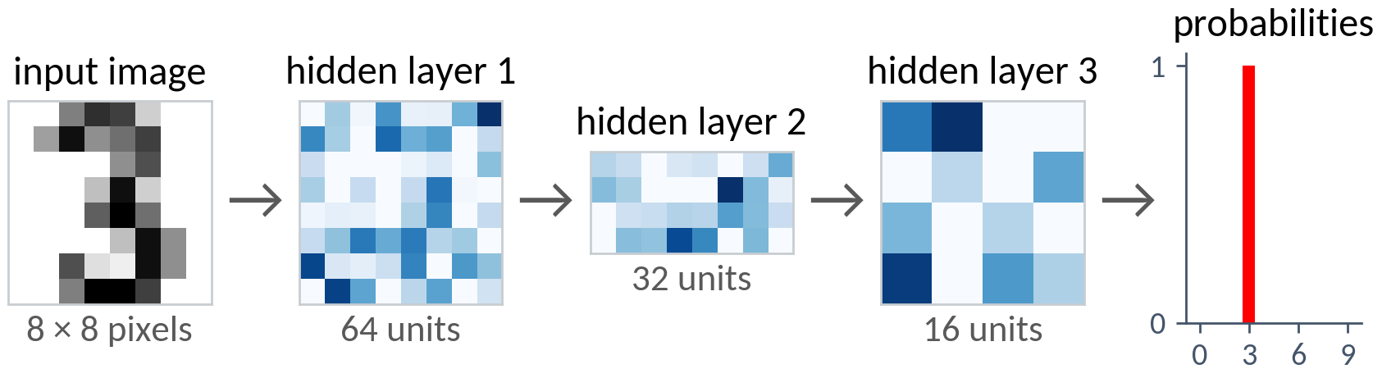
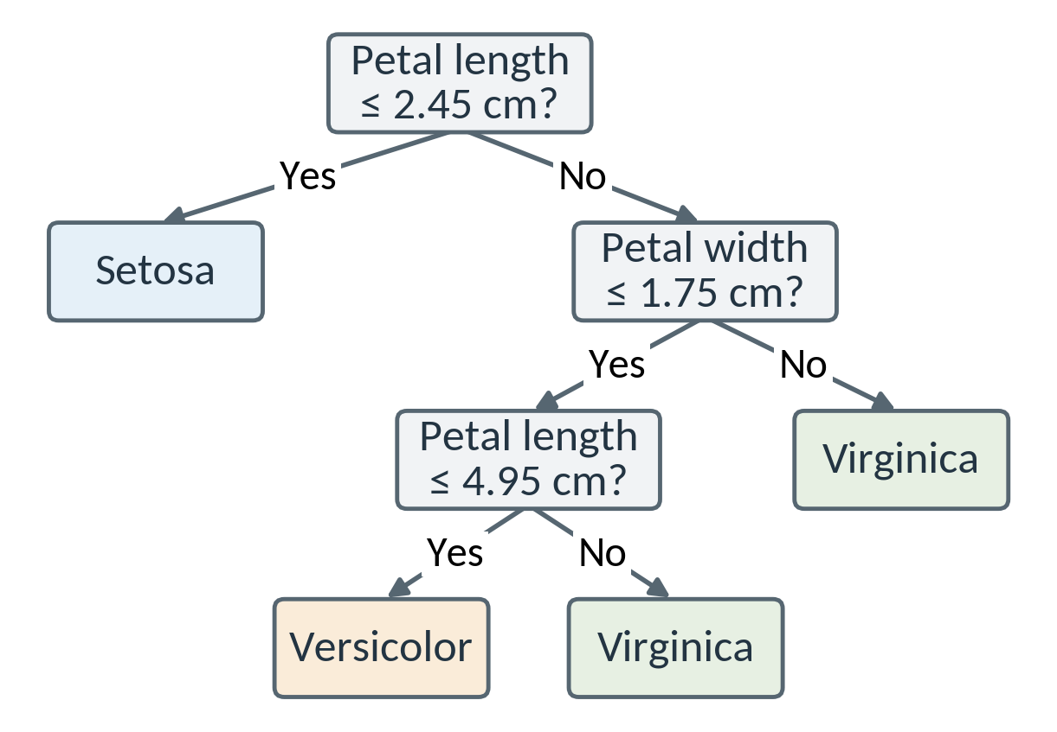
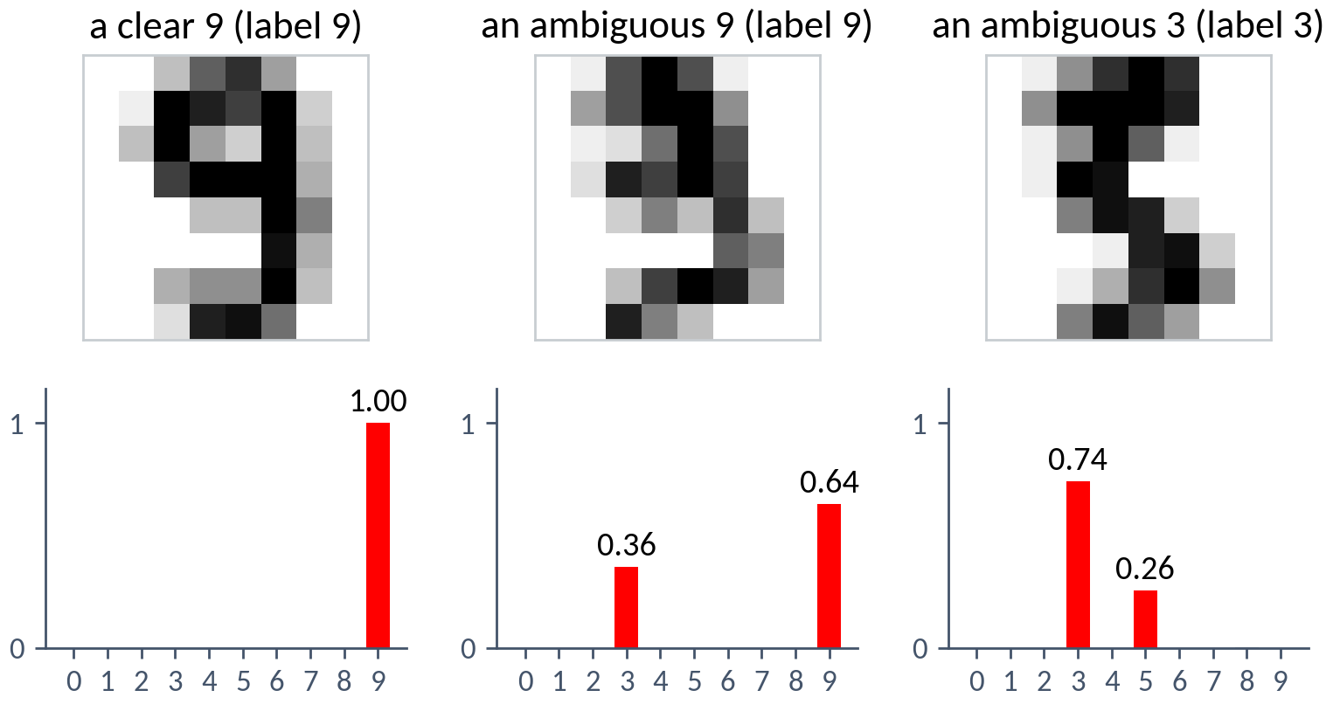
Basic AI/ML/DL Terminology
Artificial intelligence
Computational systems that perform tasks associated with human intelligence: perception, reasoning, language, planning, action. Methods: search, logic, probabilistic reasoning, learning.
Machine learning
Algorithms that learn from data and generalize to unseen data, instead of having every rule programmed. Foundations: statistics and optimization.
Deep learning
Machine learning with multilayer neural networks: many trainable transformations, composed, learn intermediate representations (features) along with the prediction.
Kasparov (left) and Deep Blue's terminal (right), Philadelphia, 1996
Example: iris flowers. From 150 labeled flowers, the learning algorithm chose the questions, the thresholds, and the labels at the leaves. Petals 4.5 cm by 1.2 cm: No, Yes, Yes, so Versicolor. Machine learning without deep learning.
Example: Deep Blue searched the game tree and scored positions with an evaluation function designed mostly by hand: intelligent behavior from search, with almost no learning.
A held-out 8×8 digit passes through three hidden layers, whose activations are learned features. The output is a probability distribution; an ambiguous digit splits it between two classes.
Notes:
Foundations 1, Disciplines. AI names both the capability and the field. Deep Blue is the search tradition (some evaluation weights were tuned automatically). The iris tree (4 leaves) misclassifies 4 of 150 training flowers. The digit network (64-32-16 hidden units) is 98% correct on held-out 8x8 digits. Photo as in Foundations 1 (RTVE).

Slide 30
Basic AI/ML/DL Terminology
Learning from experience
A program learns from experience E with respect to a class of tasks T and a performance measure P if its performance on tasks in T, as measured by P, improves with E.
Tom Mitchell, Machine Learning (1997)
iris flowers
a language model
T
task
name a flower's species
predict the next token of text
E
experience
150 labeled flowers
a corpus of documents
P
performance
fraction named correctly
average log probability of held-out text
Notes:
Foundations 1, Learning from experience: Mitchell's definition (Machine Learning, 1997), in the lecture notes' wording. For a language model, T is predicting the next token, E a corpus of documents, P the average log probability of held-out text.

Slide 31
Basic AI/ML/DL Terminology
Describing an ML system
dimension
question
examples
Learning paradigm
What feedback is available?
supervised, unsupervised, or reinforcement learning
Learning setting
When does learning occur?
offline or online learning
Task
What result is required?
a class label, a number, a grouping, or a distribution
Model and algorithm
What is represented, and how is it learned?
a linear predictor fitted by gradient descent
Learning, prediction, and action
What is the system doing at a given moment?
updating a model, computing an output, or acting on it
The descriptions apply together: a classifier can be trained by supervised learning on an offline dataset, then used to predict as new inputs arrive. The next slides take the dimensions one at a time.
Notes:
Foundations 1, Learning from experience: the table of dimensions along which an ML system is described. The learning paradigm specifies the available feedback; the setting, when examples arrive and the model is updated; the task, the required result; models and algorithms, the mathematical objects and procedures. Statistical learning theory studies how learning algorithms use data to construct predictors that generalize.

Slide 32
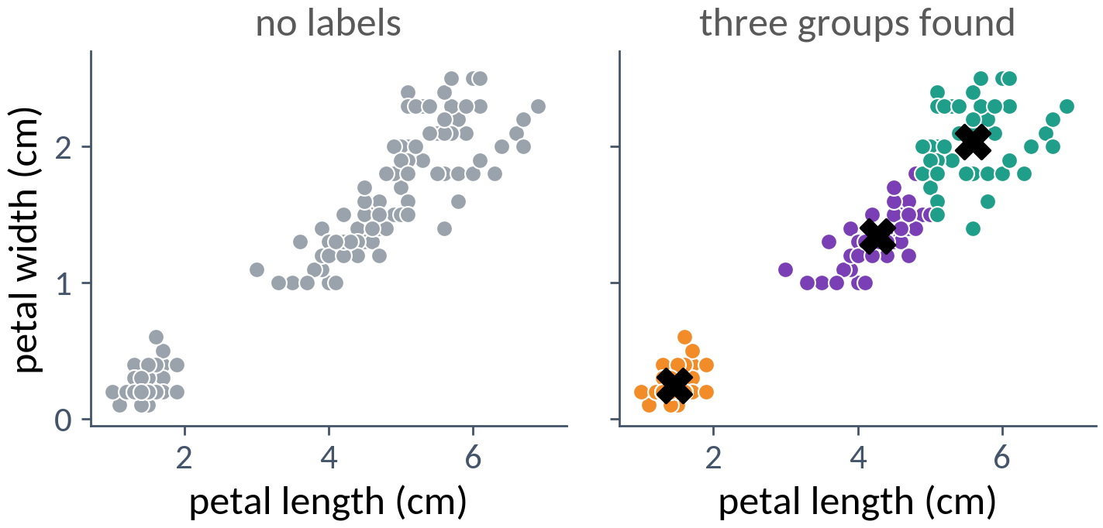
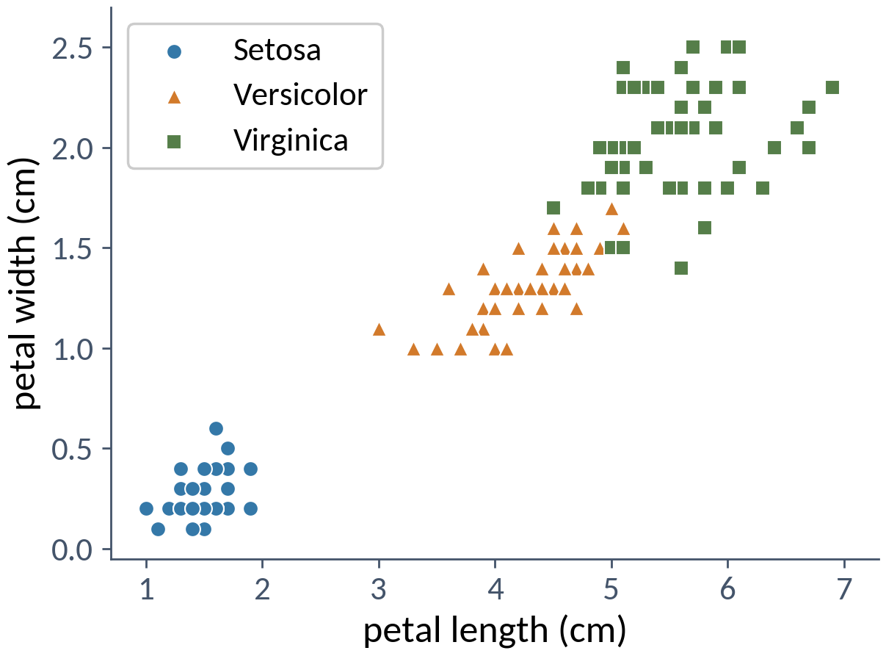
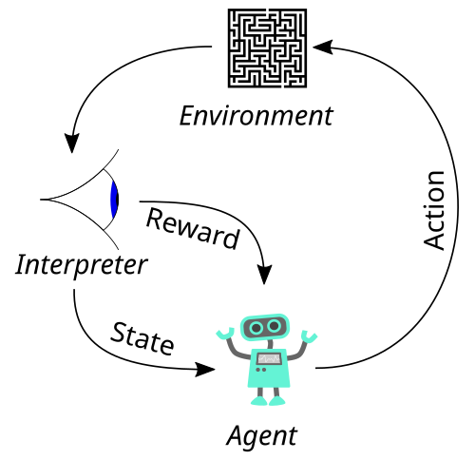
Basic AI/ML/DL Terminology
Learning paradigms: where the learning signal comes from
Supervised: each input comes with a target. Learn to predict the target for new inputs.
Unsupervised: inputs only. Find structure: groups, a density, a representation.
Self-supervised: targets constructed from the data itself, such as the next word.
Reinforcement: act and receive rewards; the actions change what is seen next.
the cat sat on the ___
The same flowers without their species. k-means finds three groups that match the species for 144 of the 150 flowers; the groups depend on the features and on the chosen notion of similarity.
the agent–environment loop (Foundations 1)
The agent's actions change what it observes next, so the data depend on the behavior being learned. A reward says how good the action was, not which action was best, and may arrive long after.
Each flower comes with its species, the label. The learner must name the species of flowers it has not seen: what matters is the error on new examples, estimated on held-out ones.
The target, the next word, is already in the text: nobody labels anything. The calculation is an ordinary supervised loss. Language models are pretrained this way.
One Transformer: self-supervised pretraining → supervised fine-tuning → rewards.
Notes:
Foundations 1, Learning paradigms. Self-supervision is often grouped with unsupervised learning, though the constructed problem has inputs and targets. RL: an agent acts to maximize expected cumulative reward; exploration versus exploitation. These categories describe the source of the signal, not the architecture. RL diagram: Reinforcement learning diagram.svg (Megajuice, CC0, Wikimedia Commons), as in Foundations 1.

Slide 33
Basic AI/ML/DL Terminology
Online and offline learning
Offline: fit on a dataset collected beforehand; the deployed model stays fixed between training runs.
Online: update the model as examples arrive, interleaving prediction and updates.
Offline learning
Online learning
fits a model to a previously collected dataset
updates a model as further examples arrive
keeps the deployed model fixed between training runs
interleaves prediction and model updates
can revisit stored examples over many passes
often processes a stream with limited storage
Not about the internet. Mini-batches do not make training online. Reinforcement learning can be offline too: learning a policy from a fixed log of another policy's actions.
Notes:
Foundations 1, Online and offline learning. Offline is also called batch learning; mini-batch SGD on a fixed dataset is still offline. Online supervised learning (a spam filter updated as users correct it) is not RL: its predictions do not choose which emails arrive next.

Slide 34
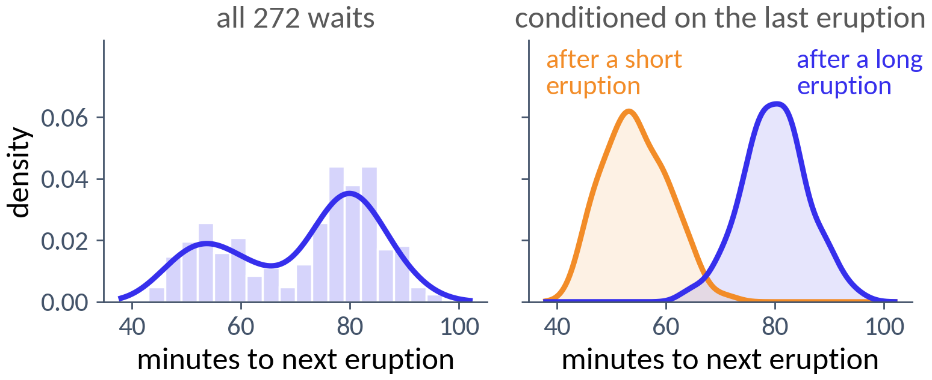
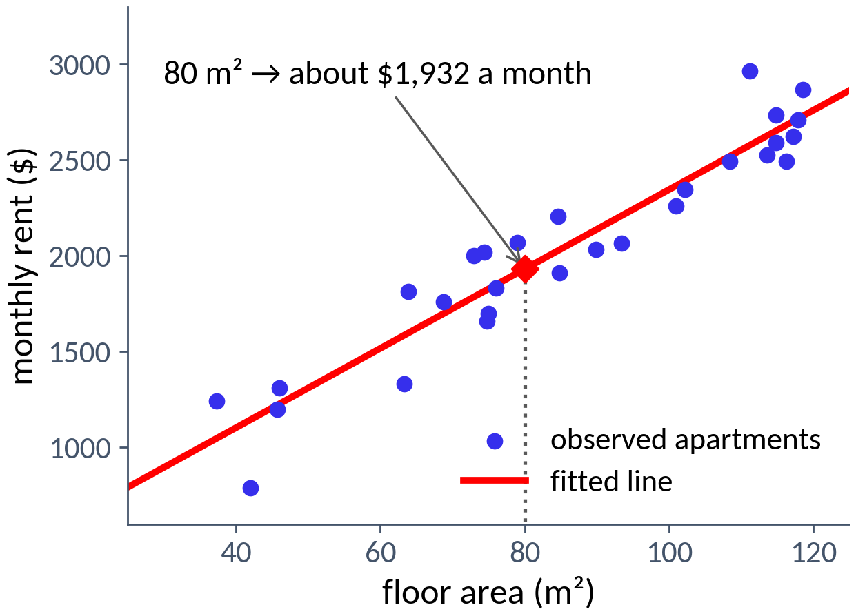
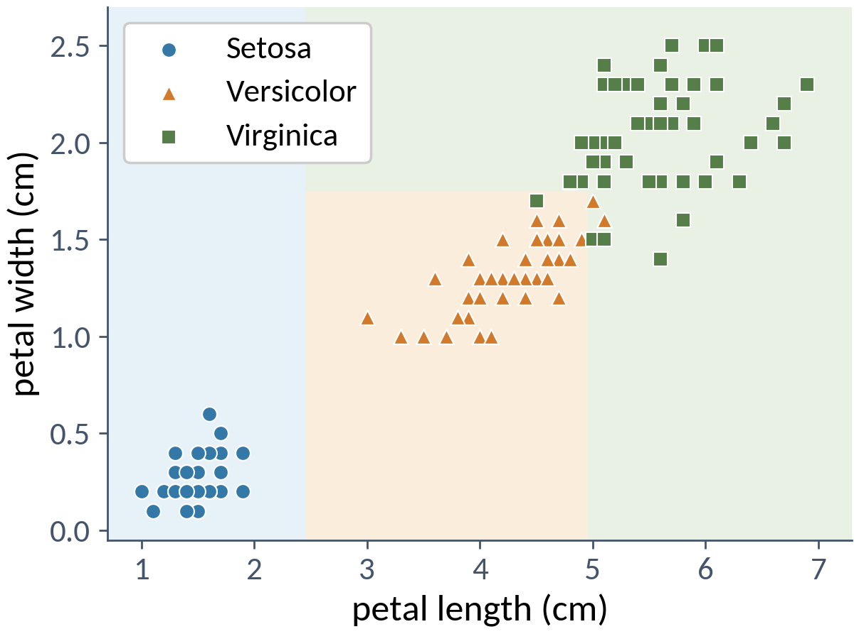
Basic AI/ML/DL Terminology
Tasks: what result is required
Classification: assign a category, or class probabilities.
Regression: predict a number.
Density estimation: estimate how the observations are distributed.
Old Faithful: 272 waits between eruptions. The density has two peaks, near 54 and 80 minutes, and the mean, 71, is rarely what happens. Conditioning on the last eruption separates the two.
A language model is a density estimator for text; generating text is sampling from it.
The tree splits the plane into regions, one per species; the decision boundary is where the prediction changes. Coding the species as 0, 1, 2 would not make this regression.
Floor area to monthly rent (synthetic data). The fitted line gives a rent for any area in range; the observed rents need not lie on it.
Notes:
Foundations 1, Tasks: classification, regression, clustering, dimensionality reduction, density estimation, anomaly detection, sequential decision-making. A task is a reusable mathematical part of a practical problem; a supervised dataset D = {(x_i, y_i)}. Old Faithful: R's faithful data; 17% of waits lie between 66 and 76 minutes, 43% between 75 and 85.

Slide 35
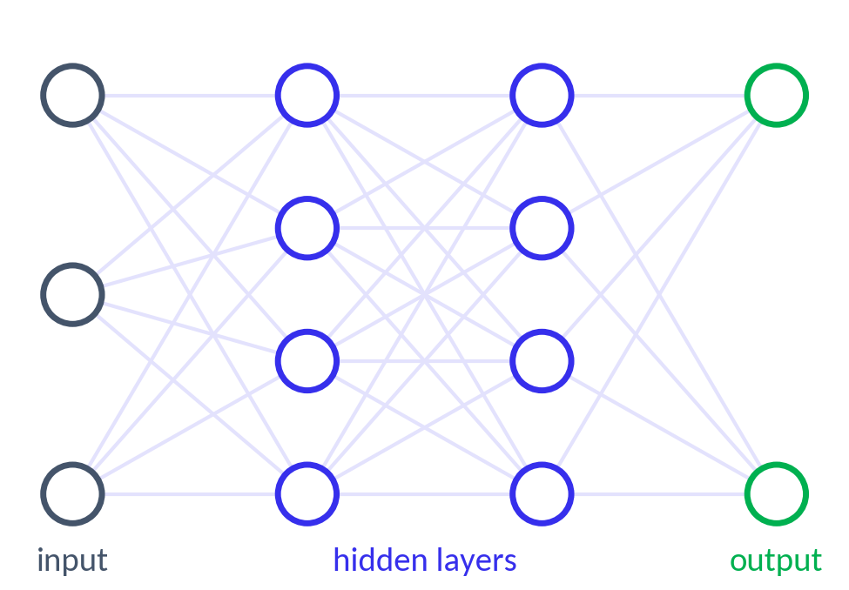
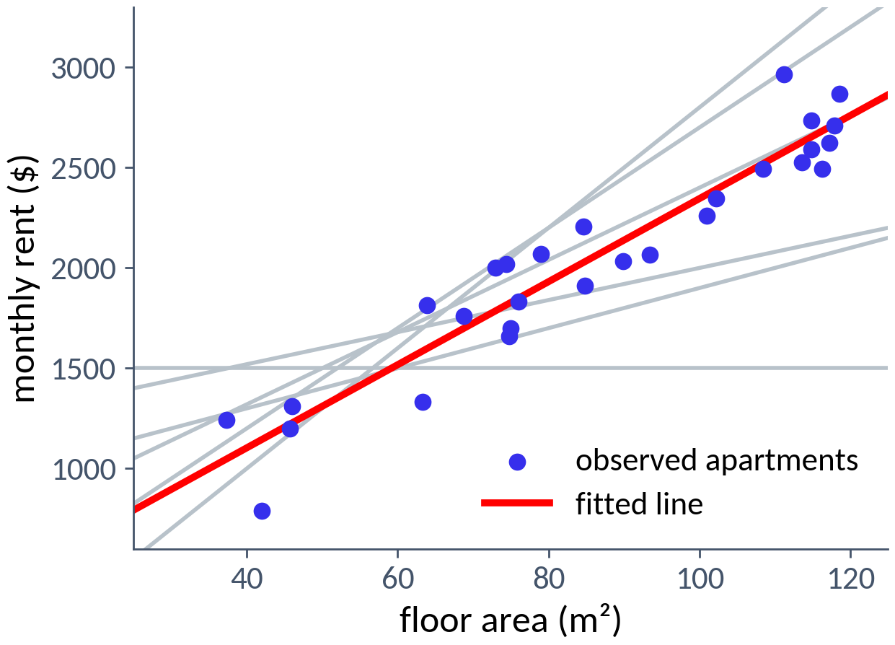
Basic AI/ML/DL Terminology
Models, parameters, and architectures
Model: represents a relationship or a distribution.
Model class: the family considered; training picks one member.
Parameters are learned (weights); hyperparameters are chosen outside learning (width, learning rate).
Representation: the form in which the input reaches the model.
Architecture: the form of the computation; it fixes the model class.
Learning algorithm: data to parameters. Applying the fitted model is prediction.
“dog bites man”
“man bites dog”
{bites: 1, dog: 1, man: 1}
A bag of words gives both the same representation; a sequence of tokens keeps them apart. Representations can also be learned: each hidden layer computes a new one.
The architecture is chosen; training chooses the weights. Logistic regression is one linear map and a sigmoid; a Transformer uses the same parameters at every position.
Each intercept and slope gives a candidate line (gray); fitting picks the red one. A neural network with a fixed architecture is the same idea with millions of parameters.
blue: mathematical objects green: learned from data red: chosen by us
Notes:
Foundations 1, Models and model classes; parametric and nonparametric; parameters and hyperparameters; neural networks; representation learning.

Slide 36
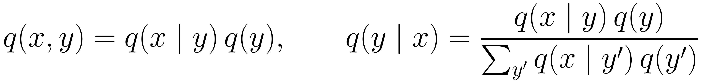
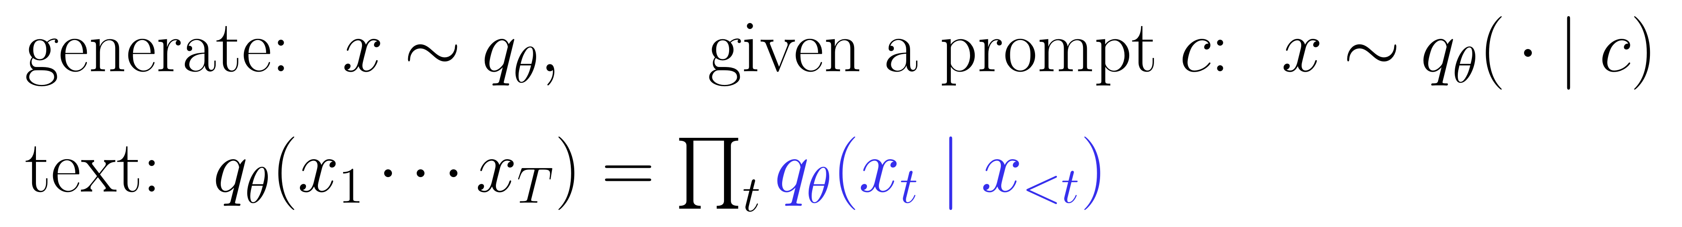
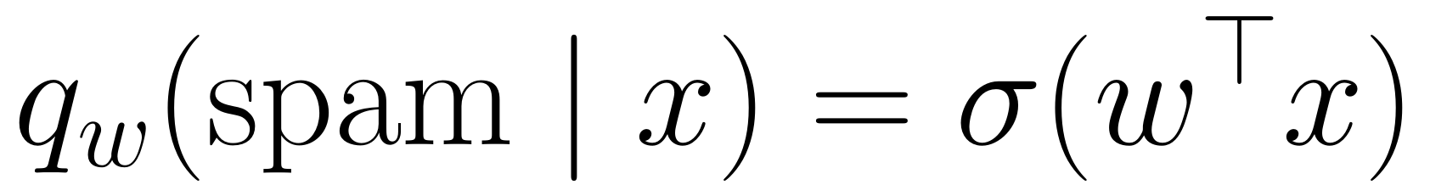
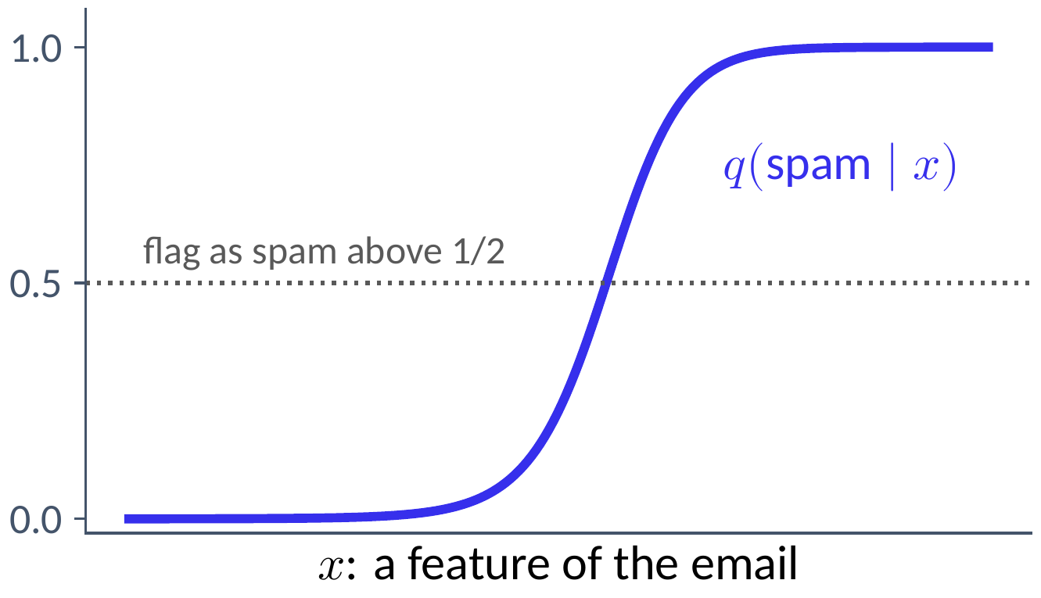
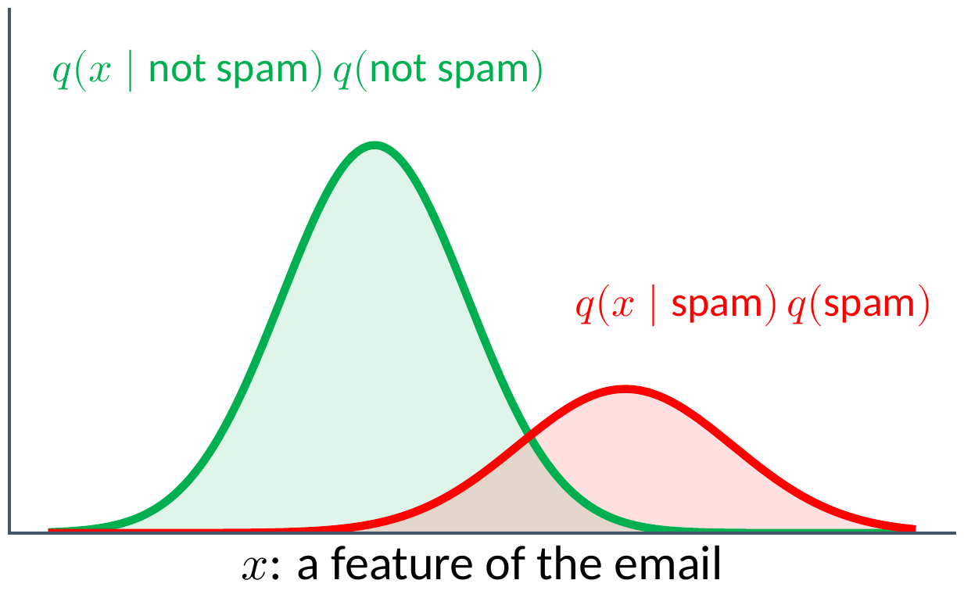
Basic AI/ML/DL Terminology
Generative and discriminative models
Discriminative: model the label given the input, and nothing else.
Generative: model how the inputs arise in each class, then classify with Bayes' rule.
Generative model: a probability distribution over the objects themselves, fitted to data. Generating means sampling; a conditional model samples given a prompt. A language model is a generative model of text.
Sampling from a model of images gives new faces; sampling from a language model, token by token, gives new text.
Model each class's distribution of x, weighted by how common the class is; Bayes' rule turns them into the same kind of curve. The model can also produce new x.
Logistic regression fits this curve directly. It classifies, but it says nothing about how emails are distributed, so it cannot produce one.
Both classify. Only a generative model can produce new inputs.
Notes:
Foundations 1 and notes §3, Generative and discriminative models. A generative model is a probability distribution q_theta over the objects themselves, fitted so that it is close to the unknown distribution of the data; generating means sampling x ~ q_theta; a conditional generative model samples x ~ q_theta(. | c) given a prompt or label c. A generative classifier models q(x, y) = q(x | y) q(y) and classifies with Bayes' rule; a discriminative one models q(y | x) directly (Ng and Jordan 2001). The curves are illustrative (two Gaussian classes, prior 0.3 for spam).

Slide 37
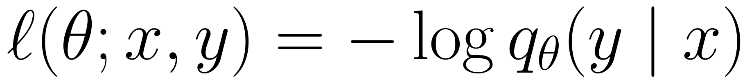




Basic AI/ML/DL Terminology
Losses, risk, and generalization
Loss: the cost of one prediction. Log loss: minus the log probability of what happened.
Risk: the average loss on new examples. We can only compute it on the training set: the empirical risk.
Overfitting: the training loss falls while the loss on new examples rises.
Training, validation, and test data: fit, choose, and estimate: three separate jobs.
training: fit the parameters
validation: make the choices
test: estimate performance, once
Empirical risk minimization picks the model with the smallest training loss, often with regularization. Small training loss does not by itself establish generalization.
Polynomials of degree 1, 3, and 11 fitted to 15 noisy points. As the degree grows, the training error keeps falling, while the error on fresh points falls and then rises.
The separation is about information flow: a test set used to choose a model has become part of development. For text, split by document and remove duplicates.
Assigning low probability to what actually happened is costly; a model that says 0.99 and is wrong pays much more than one that says 0.6.
Notes:
Foundations 1, Losses and objectives; training, validation, and test data. Loss l(y, y_hat) with the target first. Generalization is estimated, not proved.

Slide 38
Basic AI/ML/DL Terminology
Learning, prediction, and action
learning (training)
prediction (inference)
action
training data
learning algorithm
trained model
prediction
decision rule
action
new input
costs and constraints
“Inference” is overloaded:
Term | Meaning | Example
statistical inference | reasoning from data to unknown quantities, with their uncertainty | a confidence interval for a model's accuracy
probabilistic inference | computing a quantity within a specified model | the probability of spam given an email's words
inference (deployment) | running a trained model | generating a response to a prompt
Notes:
Foundations 1, Learning, prediction, and action. Learning changes the model; prediction computes its output (inference, in deployment); a decision rule, with costs and constraints, determines the action. An offline-trained model can serve online, real-time predictions. A learned RL policy selects actions directly. The inference table is from Section 3 of the lecture notes.

Slide 39

Basic AI/ML/DL Terminology
Example: a spam filter
practical problem
help a user manage unwanted email
abstract task
binary classification
learning paradigm
supervised, from labeled emails
learning setting
offline training on a collected dataset
input and target
features of an email; label spam or not
model family
logistic regression: a probability of spam
training objective
average log loss (binary cross-entropy), maybe regularized
training algorithm
gradient descent on that objective
trained model
the fitted weights and the rule they define
prediction
the probability that a new email is spam
action
a decision rule flags or routes the email
Notes:
Foundations 1, Example: a spam filter. Colors follow the previous slide: learning blue, prediction green, action red. If user corrections update the model as they arrive, the setting becomes online.

Slide 40
Lecture 1: (Artificial) Intelligence, Learning, Language, and Meaning
Short timeline highlighting language and its modeling, course description: what we will study and build
Basic AI/ML/DL terminology
Understanding
  Intelligence
  Learning
  Language
  Meaning
Hands-on: an autograd engine
Notes:
Next: understanding intelligence, learning, language, and meaning.

Slide 41









Understanding Intelligence
Turing's question
1637 Descartes: a machine could never arrange words to reply sensibly to whatever is said, as even the dullest person can.
1843 Lovelace: the Analytical Engine “has no pretensions to originate anything”; it does only what it is ordered to do.
1949 Jefferson: no machine equals the brain until it writes a sonnet from thoughts and emotions felt. The question reaches the newspapers.
1950 Turing: “Can machines think?” is too ill-defined; replace it with a game. Build a child machine, and educate it.
What lasts is the method: replace “does it understand?” by “what does it compute, and how well, on a specified distribution of tasks?”
1966 ELIZA: a few pattern-matching rules left some users sure that it understood them. As a definition of intelligence, imitation is poor.
1980 The Chinese room: the attack from the other side: even flawless behavior, Searle argues, would not show understanding.
John Searle
Alan Turing
the imitation game
Ada Lovelace
Babbage's Analytical Engine, trial model
ELIZA in a modern reimplementation
Joseph Weizenbaum
A person with a rulebook answers Chinese questions sensibly without understanding Chinese. Reply: the whole system is the candidate. A language model is a learned procedure with no single part playing the person; the analogy sharpens the question of §7: can meaning be learned from form alone?
Computing Machinery and Intelligence (1950). Turing predicted that by about 2000 an average interrogator would have at most a 70% chance of a correct identification after five minutes. Most of the paper answers objections; its last section, “Learning Machines”, asks “why not rather try to produce one which simulates the child's?”
Imitating humans is anthropocentric, rewards deception, and invites people to attribute understanding on thin evidence. Turing did not offer the game as a definition.
the Manchester Baby, the first stored-program computer (1948; replica)
Her notes on the Analytical Engine (1843): it can do whatever we know how to order it to perform, and nothing more.
René Descartes, after Frans Hals
Geoffrey Jefferson's lecture of 1949 was widely reported. Stored-program computers were running in Manchester and Cambridge; Turing worked on Manchester's.
Discourse on the Method, Part V (1637): language, used sensibly in any situation, is what a machine could never do.
Notes:
Notes §4, Turing's question. Descartes (1637); Lovelace (1843); Jefferson (1949); Turing (1950): 10^9 bits, 70 percent, five minutes; the child machine. The lasting value of the game is methodological: a behavioral specification of the task. As a definition it is poor. Weizenbaum (1966), ELIZA: behavior can suggest more understanding than there is. Searle (1980), the Chinese room: even flawless behavior would not establish understanding; the systems reply. Pictures, Wikimedia Commons: Descartes after Frans Hals (public domain); Ada Lovelace portrait.jpg (public domain); Analytical engine trial model, Science Museum (Daderot, CC0); SSEM Manchester museum.jpg (Parrot of Doom, CC BY-SA 3.0); ELIZA conversation.png (public domain); Joseph Weizenbaum (Andreas Schepers, CC BY 2.0); John Searle speaking at Google 1.jpg (FranksValli, CC BY-SA 4.0).

Slide 42


Understanding Intelligence
Definitions and measures
Russell and Norvig: thinking or acting, measured against humans or against an ideal of rationality.
Legg and Hutter: universal intelligence: expected performance across all computable environments, the simple ones weighted most.
Chollet: skill is not intelligence, since enough data buys skill. Measure skill-acquisition efficiency.
thinking
acting
thinking humanly
cognitive modeling
thinking rationally
laws of thought
human
V: the agent's expected performance in environment μ. K(μ): the length of the shortest program for μ, so simple environments count most. It captures an intuition, but it is incomputable, so it cannot be a benchmark (§A.1).
acting humanly
the Turing test
acting rationally
the rational agent
ideal
an ARC-style puzzle: two examples, then a new input
A language model trained on much of the written record may show great skill on a benchmark; that says little about how efficiently it learns.
Russell and Norvig adopt the rational agent: it perceives its environment and acts to maximize the expected value of a performance measure. Intelligence becomes optimization, the view behind reinforcement learning in Week 6.
Notes:
Notes §4, Definitions and measures. Russell and Norvig, Artificial Intelligence: A Modern Approach. Legg and Hutter (2007), Universal intelligence. Chollet (2019), On the Measure of Intelligence (ARC). Figures drawn for the course.

Slide 43







Understanding Intelligence
Symbols, networks, and the Dartmouth conjecture
1955 Dartmouth: every feature of intelligence can in principle be described so precisely that a machine can simulate it.
The symbolic program: intelligence is manipulating symbols by rules (Newell and Simon): theorem provers, planners, expert systems, grammars.
The connectionist program: simple units adjusting their connections: McCulloch and Pitts (1943), Rosenblatt's perceptron (1958).
1969 Minsky and Papert: one layer cannot compute parity or connectedness; the program stalled until backpropagation.
A language model is connectionist, yet it reads and writes symbols. Does it manipulate symbols in Newell and Simon's sense? Open.
Dartmouth College
Herbert Simon and Allen Newell
The proposal's topics: how a computer can use a language, neuron nets, self-improvement, abstraction, randomness and creativity. Almost all are topics of this course.
Frank Rosenblatt
A network of simple units whose connections are learned, operating on discrete symbols, and prompted to carry out symbolic procedures, sometimes reliably and sometimes not.
The physical symbol system hypothesis: a physical symbol system has the necessary and sufficient means for general intelligent action.
Networks of threshold units can compute any Boolean function; the perceptron learns its weights from labeled examples.
exclusive or: no single line separates the classes
Minsky and Papert's Perceptrons (1969). Multilayer networks could compute it, but there was no effective way to train them.
Notes:
Notes §4, Symbols, networks, and the Dartmouth conjecture. Newell and Simon (1976), physical symbol system hypothesis; McCulloch and Pitts (1943); Rosenblatt (1958); Minsky and Papert (1969). Photos, Wikimedia Commons: Herbert A. Simon and Allen Newell Chess Match.jpg (public domain); Frank Rosenblatt.jpg (CC BY-SA 4.0); Dartmouth Hall (Kenneth C. Zirkel, CC BY 4.0).

Slide 44


Understanding Intelligence
Search and learning: Deep Blue and AlphaGo
1997 Deep Blue: deep search, with an evaluation built by hand from thousands of features; 480 custom chips. Its knowledge came from people, its strength from search.
2016 AlphaGo: about 250 legal moves per position, and no good hand-written evaluation. A policy network and a value network, learned from expert games and self-play, combined by tree search.
Both search; they differ in where the knowledge comes from: written down by people, or learned from data. The same division runs through this course.
AlphaGo
a language model
learned policy
which move to try
which token comes next (pretraining)
improved by reward
self-play
post-training with rewards (Week 7)
search at play time
tree search
sample, verify, search (Week 8)
A pretrained language model is a learned policy over next tokens; rewards improve it as self-play improved AlphaGo's; test-time computation is search around a learned model.
Go resisted hand-written evaluation; AlphaGo learned the functions it needed.
On the order of a hundred million positions per second.
Notes:
Notes §4, Search and learning. Game playing makes the contrast between written-down and learned knowledge sharp, because success is unambiguous. Deep Blue: Campbell, Hoane, and Hsu (2002). AlphaGo: Silver et al. (2016). Figures drawn for the course.

Slide 45


Understanding Intelligence
The bitter lesson
2019 Sutton: across seventy years of AI, general methods that exploit computation, search and learning, eventually beat methods that build in human knowledge. Empirical, not a theorem; structure still matters.
2025 Sutton: language models learn from text that humans wrote, not from their own experience; systems that learn from experience will overtake them.
Richard Sutton on the Dwarkesh Podcast (2025)
Keep this in mind in Weeks 6 and 7, where language models do learn from rewards for their own outputs.
From hand-written grammars to n-grams to neural models trained on trillions of tokens. The Transformer is itself a carefully designed structure; Weeks 3 and 4 ask which choices matter at scale.
Notes:
Notes §4, The bitter lesson. Sutton, The Bitter Lesson (2019), http://www.incompleteideas.net/IncIdeas/BitterLesson.html; Sutton with Dwarkesh Patel (2025), https://www.youtube.com/watch?v=21EYKqUsPfg. Thumbnail: Dwarkesh Podcast.

Slide 46


Understanding Learning
The problem of induction
1748 Hume: no argument from experience shows that the unseen will resemble the seen, without assuming the regularity it sets out to prove.
No free lunch: if every labeling is equally likely, every learner has expected error 1/2 on the unseen points.
Inductive bias: learning works because real functions are simple: smooth, compositional. A learner succeeds by preferring them.
After seeing the labels of any subset, each unseen label is still a fair coin, independent of everything seen.
In a language model the inductive bias lives in the tokenizer, the architecture, the optimizer, the order of the data, and the objective.
David Hume, by Allan Ramsay (1766)
An Enquiry Concerning Human Understanding (1748).
Notes:
Notes §5, The problem of induction. Hume (1748); Wolpert (1996), no-free-lunch theorems.

Slide 47




Understanding Learning
Learning as a computational problem
1984 Valiant: PAC learning. From m examples of an unknown target in a known class, output a hypothesis with small error, with high probability, in polynomial time.
The distribution is the assumption that the future resembles the past; the class is the inductive bias.
The Occam bound: a learner that fits every example needs only about the number of bits that name a hypothesis.
Time can bind: automata are hard to learn from random examples and easy with queries (Angluin's L*). What you can learn depends on how you ask.
For all Boolean functions on n bits, ln|H| is exponential in n: no free lunch again, now as a sample size (§A.2).
Pretraining supplies random examples; fine-tuning, chosen demonstrations; preference learning, comparisons; verifiable rewards, something like answers to queries.
Leslie Valiant
Notes:
Notes §5, Learning as a computational problem. Valiant (1984); Angluin (1987), L*. Photo: Leslie Valiant.jpg (Renate Schmid, CC BY-SA 2.0 de).

Slide 48




Understanding Learning
From the perceptron to deep learning
The perceptron: classify by the sign of a weighted sum; on each mistake, add the example to the weights.
Novikoff (1962): if a margin γ separates the data and inputs have norm at most R, it makes at most (R/γ)² mistakes, whatever the dimension.
One unit draws one line: exclusive or is out of reach.
Stack units: two hidden units each draw a line; the output unit weighs their votes.
Backpropagation: hidden units have no targets. Make every unit differentiable and follow the gradient: the chain rule assigns the blame.
The output unit labels a point positive when it lies on the positive side of both lines: a weighted vote over the units below.
Rumelhart, Hinton, and Williams (1986)
(0, 1) and (1, 0) are positive, (0, 0) and (1, 1) negative: no line separates them.
Replace the hard threshold by a smooth function such as the sigmoid; the gradient of the loss tells each hidden unit which way to move.
The bound depends on the geometry of the data, not on the dimension or the number of examples.
Notes:
Notes §5, From the perceptron to deep learning. Novikoff (1962); Minsky and Papert (1969); Rumelhart, Hinton, and Williams (1986).

Slide 49






Understanding Learning
Neural networks and gradient descent
A layer: an affine map, then a fixed nonlinearity. One wide hidden layer approximates any continuous function (Cybenko, Hornik).
Expressivity is not learnability: the theorem says nothing about size, data, or whether gradient descent finds it.
Parameter sharing: same filter everywhere (convolutions), same update each step (recurrence), same parameters at every position (attention).
Gradient descent: step against the gradient; stochastic gradient descent uses a random minibatch.
One step: improves the prediction on the example it was computed from. Other examples: only held-out data can tell.
expressivity
optimization
generalization
can the class represent it?
will the procedure find it?
does it work on new inputs?
Universal approximation answers only the first. Parity of a few hidden bits is easy to express and notoriously hard for gradient methods.
Logistic regression with log loss: the gradient on one example is the prediction error times the input.
Each architecture's sharing encodes an assumption about the data. Weeks 2 and 3 develop recurrence and attention.
Without the nonlinearity the stack collapses to a single affine map.
Momentum, Adam, and AdamW adapt the step using the history of gradients (Week 5).
Notes:
Notes §5, Neural networks and gradient descent. Cybenko (1989); Hornik (1991); LeCun, Bengio, and Hinton (2015).

Slide 50




Understanding Learning
Prediction is compression
Log loss is code length: a symbol predicted with probability p can be encoded in about −log₂ p bits (arithmetic coding). Conversely, every prefix code is a probability model (Kraft).
Cross-entropy: coding a source p with a model q costs H(p) + KL(p‖q) bits per symbol. A better predictor is a better compressor; the gap to the best code is exactly the KL divergence.
Training is compression: maximum likelihood minimizes the KL divergence from the data distribution, so a language model trained on next-token log loss is a compressor for text. It runs the other way too: gzip can generate text (GziPT).
Simplicity, briefly: naming a hypothesis costs bits too. Minimum description length: prefer the hypothesis whose own description plus the data coded with it is shortest.
The entropy does not depend on θ, so maximizing likelihood minimizes the KL divergence to the data. Perplexity in Week 2 is this quantity, exponentiated.
H(p), the entropy of the source, is the best any code can do. The KL divergence is nonnegative and zero only when q = p.
Grant Sanderson (3Blue1Brown), But what is cross-entropy?
A hypothesis earns its complexity only by compressing the data. Solomonoff's mixture over programs cannot be computed, but on any computable source its total error is bounded by the source's description length (§A.4).
Probability 1/2: one bit; 1/4: two bits; 1/64: six bits. For a whole message, arithmetic coding comes within two bits of −log₂ q(x).
Learning is prediction, and prediction is compression: good prediction, short description, and simplicity are three views of one idea.
Notes:
Notes §5, Prediction is compression. Arithmetic coding: at most -log2 q(x) + 2 bits; Kraft's inequality. Cross-entropy H(p,q) = H(p) + KL(p||q). Maximum likelihood = minimum KL. Grant Sanderson, But what is cross-entropy? (Compression is Intelligence, part 2); Nathan Barry, GziPT (nathan.rs/posts/gzip-lm). Rissanen (1978), minimum description length; the Occam bound's ln|H| is the length of a hypothesis's name. Solomonoff (1964).

Slide 51



Understanding Language
What a sentence is
A sequence of marks: symbols on a page or sounds in time.
A grammatical construction: words grouped into phrases by rules.
An expression about something: it refers, and can be true or false.
A move in an interaction: it asks, tells, promises, or requests.
Use and intent: §7.
Venus: “the morning star” and “the evening star”
Structure: next slide.
a student's exercise tablet in cuneiform (Metropolitan Museum of Art)
Reference: §7.
This section: structure and statistics. Meaning and use come next.
Notes:
Notes §6, What a sentence is. Pictures: cuneiform tablet (The Metropolitan Museum of Art, CC0); Venus (NASA/JPL-Caltech, public domain).

Slide 52



Understanding Language
Rules and productivity
Pāṇini's Aṣṭādhyāyī: about four thousand rules that derive the forms of Sanskrit; the oldest grammar that survives complete.
Productivity: a finite description determines unboundedly many expressions, including ones never observed.
1956 Chomsky: a grammar is a finite device that generates exactly the grammatical sentences; the hierarchy classifies such devices.
the cat saw the dog
the cat saw the dog that chased the rat
the cat saw the dog that chased the rat that ate the cheese
…
a manuscript of the Aṣṭādhyāyī, Southern Grantha script
Usually dated to the middle of the first millennium BCE. Pāṇini names ten earlier grammarians, whose works are lost.
One rule for relative clauses, applied again and again: a finite description, unboundedly many sentences, most never observed.
Noam Chomsky
Three Models for the Description of Language (1956). The course takes the statistical route (Weeks 2 and 3).
Notes:
Notes §6, Rules and productivity. Photos: Panini Astadhyayi manuscript (Ms Sarah Welch, CC BY-SA 4.0); Noam Chomsky portrait 2015.jpg (Augusto Starita, CC BY-SA 2.0).

Slide 53



Understanding Language
Learning a language from examples
1967 Gold: shown a language's strings in any order, no learner identifies even the regular languages: it cannot detect overgeneralization.
1980 Angluin: exactly which classes are learnable from positive examples (tell-tale sets). The poverty of the stimulus (Chomsky).
1969 Horning: from random samples, probabilistic context-free grammars are learnable: frequencies are evidence.
2024 Kleinberg and Mullainathan: generating new valid strings is possible for every countable class. The catch: validity against breadth.
A construction that should appear often but never does is evidence that it is ungrammatical. Learning from random samples, with frequency as evidence, is the setting of a language model.
Hallucination against mode collapse: for next-token predictors, being both valid and broad is impossible for most classes (Kalavasis, Mehrotra, Velegkas 2025), unless negative examples are supplied; Kleinberg and Wei (2025) keep a positive fraction.
Gold's learner guesses a grammar after each string and must eventually settle on a correct one. With negative examples too, much larger classes become learnable.
Notes:
Notes §6, Learning a language from examples. Gold (1967); Angluin (1980); Chomsky (1959); Horning (1969); Kleinberg and Mullainathan (2024); Kalavasis, Mehrotra, and Velegkas (2025); Kleinberg and Wei (2025).

Slide 54



Understanding Language
Prediction and statistics
1948 Shannon: English as a stochastic source: letters, then letters given the previous ones, then words given the previous word.
1951 the guessing game: people guessing the next letter: about one bit per letter with long context (0.6 to 1.3).
1957 Chomsky: “Colorless green ideas sleep furiously” and its reversal were both unseen, so statistics must treat them alike?
2000 Pereira: a class-based bigram model prefers the grammatical one by about 200,000 times.
Colorless green ideas sleep furiously.
Furiously sleep ideas green colorless.
Syntactic Structures (1957): only the first is grammatical, although neither had presumably ever occurred.
Claude Shannon
random letters: dwugnmrvcawluamtgzya
1 letter of context: the bushery acrouanth vack
4 letters of context: the could nothinking woman
word pairs: she with such a very audible whisper
Sharing statistical strength across similar words assigns sensible probabilities to unseen sentences: the central idea of Weeks 2 and 3. Norvig (2011), On Chomsky and the Two Cultures of Statistical Learning.
Samples from counting models trained on two of Jane Austen's novels: more context, more like English.
Notes:
Notes §6, Prediction and statistics. Shannon (1948, 1951); Chomsky (1957); Pereira (2000); Norvig (2011). Photo: ClaudeShannon MFO3807.jpg (Konrad Jacobs, CC BY-SA 2.0 de).

Slide 55



Understanding Language
The company a word keeps
1954 Harris: words that occur in similar environments are similar: differences of meaning correspond roughly to differences of environment.
Six sentences: without knowing any meanings, one sees that oculist and eye-doctor share every environment, and lawyer shares half.
1957 Firth: “You shall know a word by the company it keeps.” Word vectors represent a word by statistics of its contexts; neural models learn them together with the predictor (Bengio et al., 2003).
Attention: one vector per word is too coarse: “bank” keeps different company in “the bank of the river” and “the bank raised its rates”. Attention gives each occurrence its own vector, a weighted mix of the words around it (Weeks 3 and 4).
the oculist examined the eye
the eye-doctor examined the eye
the oculist prescribed glasses
the eye-doctor prescribed glasses
the lawyer examined the contract
the lawyer drafted the contract
Distributional Structure (1954). The environment of a word here is the word that follows it.
Each word is represented by counts of the words that follow it; the cells are cosine similarities.
word vectors from counts in two Austen novels
The weights are computed from the words themselves. A word is known, quite literally, by the company it keeps in the sentence at hand.
Similar company, nearby vectors: relatives, feelings, numbers, places, and times form groups. Company is not the same as meaning: “increase” and “decrease” keep much the same company.
A language model trained to predict the next token is a learned summary of the company every word keeps.
Notes:
Notes §6, The company a word keeps. Pereira's model worked because it treated similar words alike; which words are similar? Harris (1954), Distributional Structure; Firth (1957); Bengio, Ducharme, Vincent, and Jauvin (2003), a neural probabilistic language model; attention in Week 3 and the Transformer in Week 4. Word vectors: PPMI and SVD on two Austen novels (NLTK Gutenberg). The attention weights are illustrative.

Slide 56


Understanding Meaning
What words are about
Reference: an expression picks out something in the world. “The morning star” and “the evening star” both refer to Venus, with different senses (Frege, 1892).
Composition: the meaning of a whole depends on its parts and how they combine: “Every student read a paper” has two readings.
Use: for many words the meaning is the use (Wittgenstein, 1953), and speakers communicate more than they say (Grice, 1975).
Intent: a speaker chooses an utterance to convey an intent; the listener reconstructs one from the words and the context they share.
Did all four experiments succeed?
Some succeeded.
Suggests that not all did, although it is consistent with all four succeeding; the suggestion can be cancelled: “in fact, all four did.” A purely logical analysis misses this layer.
“It's cold in here” can report the temperature, explain a coat, or ask for the window to be closed. The words fix much less than the meaning.
Gottlob Frege
Venus
Aristotle, On Interpretation: a name signifies by convention; only a combination of expressions, a statement, is true or false.
The same words, different truth conditions. A representation that records only which words occur cannot tell the readings apart.
A language model sees only text: no label for the referent or the intent is ever supplied. The text carries evidence about both. Is it enough?
Notes:
Notes §7, What words are about. Aristotle, On Interpretation; Frege (1892); Wittgenstein (1953); Grice (1975). Each relates a string to something outside it: the world, what a speaker means and does, and a shared context. Photos: Young frege.jpg (public domain); Venus (NASA/JPL-Caltech, public domain).

Slide 57



Understanding Meaning
The grounding problem
2020 Bender and Koller: a hyperintelligent octopus taps the cable between two islanders, learns the statistical patterns of their messages, and impersonates one of them convincingly.
The bear: chased by a bear and holding two sticks, one islander asks for advice. The octopus cannot help: nothing in the patterns connects the words to sticks and bears.
1990 Harnad: the symbol grounding problem: how can the symbols of a formal system mean anything to the system itself, rather than only to the people who interpret it?
A dictionary defines every word by other words. A newcomer who knows no English learns nothing from it alone: every definition leads only to more words.
Their claim: meaning cannot be learned from form alone.
Form alone: the octopus has the messages, but not what they are about.
Notes:
Notes §7, The grounding problem. Bender and Koller (2020), Climbing towards NLU: on meaning, form, and understanding in the age of data. Harnad (1990), The symbol grounding problem, including the dictionary-go-round: learning Chinese from a Chinese-Chinese dictionary alone. Octopus: Octopus vulgaris Merculiano.jpg (public domain). Figures drawn for the course.

Slide 58



Understanding Meaning
Meaning up to isomorphism
A second dictionary: if the newcomer also has a dictionary of their own language, and the two networks of cross-references have nearly the same shape, structure alone matches word to word.
Word vectors: vectors learned from each language's text separately have similar geometry: a linear map, learned from a small seed dictionary or from none, translates many words.
2022 Piantadosi and Hill: the meaning of a concept lies largely in its relations to other concepts, its conceptual role, which a model trained on text can learn.
illustrative
Mikolov, Le, and Sutskever (2013); Conneau et al. (2018), with no dictionary. The match is imperfect, and worse for languages and text collections that differ more.
The relations do not ground the words, but they fix them up to a correspondence with a language that is grounded.
Not settled, and this course does not settle it.
The precise question: what about the world and about intent can be recovered from the distribution of text, and what do demonstrations, comparisons, and checks add?
Notes:
Notes §7, Meaning up to isomorphism. Dictionaries as networks of cross-references (Figure 12 of the notes). Mikolov, Le, and Sutskever (2013); Conneau, Lample, Ranzato, Denoyer, and Jégou (2018); Søgaard, Ruder, and Vulić (2018); Jha et al. (2025), translating between the representations of different models; Piantadosi and Hill (2022). The vector picture is illustrative.

Slide 59

Understanding Meaning
Probable is not true
1948 Shannon: the semantic aspects of communication are “irrelevant to the engineering problem.” A language model inherits the stance: it is rewarded for probable text, true or not.
2024 Kalai and Vempala: for arbitrary facts, whose truth no pattern reveals, a calibrated model must generate false ones at about the rate of facts seen exactly once in training.
The scope: a lower bound for arbitrary facts only: no statistical reason to hallucinate facts seen many times or that follow patterns. To go below it, give up some calibration (post-training, Week 7) or consult a source.
Claude Shannon
Simulated facts. The fraction of facts seen once is the Good–Turing estimate of the probability of the unseen.
Entropy measures uncertainty about which message is sent, not what it says.
Notes:
Notes §7, Probable is not true. Shannon (1948); Kalai and Vempala (2024), Calibrated language models must hallucinate. For the facts it covers, hallucination is a consequence of calibrated prediction rather than an engineering defect. Photo: ClaudeShannon MFO3807.jpg (Konrad Jacobs, CC BY-SA 2.0 de).

Slide 60
Lecture 1: (Artificial) Intelligence, Learning, Language, and Meaning
Short timeline highlighting language and its modeling, course description: what we will study and build
Basic AI/ML/DL terminology
Understanding
  Intelligence
  Learning
  Language
  Meaning
Hands-on: an autograd engine
Notes:
Next: the hands-on, an automatic-differentiation engine.

Slide 61



Hands-on: an Autograd Engine
Three ways to compute a derivative
A small program: the logistic map, run for three steps. How do we get its derivative? (Figure 17 of the notes, from Baydin et al., 2018.)
Symbolic: expand the program into one formula, then differentiate. Exact, but a value used twice is copied twice.
Numerical: evaluate the program at nearby points. Approximate, and one input direction at a time.
Automatic: apply each operation's exact derivative to the values the program computes. Exact up to rounding, a constant factor more work, and it follows the loops and branches the program took.
Even the central difference keeps only about two thirds of the digits of double precision, four or five in single, one or two in 16-bit formats. A gradient in n inputs needs 2n evaluations.
After seven steps the program performs 21 operations; its derivative written as a formula has about 11,000 nodes, and each step multiplies that by more than 2.5. A program with data-dependent branches has no single formula.
The right-hand column of the figure: each value v is carried together with its derivative dv.
Against numerical differentiation, autodiff wins twice: accuracy (the smaller win) and cost (the decisive one).
Notes:
Notes §8, Three ways to compute a derivative. Figure 2 of Baydin, Pearlmutter, Radul, and Siskind (2018), CC BY 4.0. Sizes counted with sympy: 21 operations against 10,946 nodes after seven steps.

Slide 62


Hands-on: an Autograd Engine
Why reverse mode
Forward mode: carries the derivative with respect to one input forward, alongside the values: n inputs, n passes, like finite differences.
Reverse mode: starts from the single output and sends its sensitivity back to every input at once. The whole gradient costs a small constant factor more than the function (Baur and Strassen, 1983). The price is memory.
At scale: 100 million parameters: 200 million evaluations for finite differences, about 2 or 3 for forward plus backward.
For the logistic map, with a single input, forward mode is fine. For a loss with millions of parameters it is the whole difference.
In the notebook, width 1024: about 15 minutes for finite differences against about ten milliseconds for forward plus backward. This, more than the digits, is why billion-parameter networks can be trained.
Notes:
Notes §8, Why reverse mode. For n inputs and m outputs, forward mode needs about n passes and reverse mode about m; a loss has m = 1. Foundations 3 develops both modes.

Slide 63

Hands-on: an Autograd Engine
Tensors and computation graphs
A tensor: holds its data, a gradient of the same shape, its parents, and a backward rule.
Every operation records these: so evaluating a loss builds a graph from the leaves, the inputs and parameters, to the loss.
X = Tensor(rng.normal(size=(4, 3)))
W = Tensor(rng.normal(size=(3, 2)), requires_grad=True)
b = Tensor(np.array([0.5, -0.5]), requires_grad=True)
Z = X @ W + b # (4,3) @ (3,2) + (2,) -> (4,2)
L = (Z ** 2).mean() # one number
Z: shape (4, 2) op + parents: @, leaf
L: shape () op / parents: sum, leaf
L = 3.913
Part A of the Week 1 notebook, section 1. The engine computes a mean as a sum divided by a count.
tinylm/autograd.py: a few hundred lines of plain Python and NumPy.
Notes:
Notes §8, Tensors and computation graphs. Code and output from tinylm/notebooks/week01_autograd.ipynb (rng = default_rng(0)).

Slide 64







Hands-on: an Autograd Engine
The backward pass
One local rule per operation: a vector–Jacobian product. Visit the nodes in reverse topological order.
A value used twice: the contributions from its uses add: the multivariable chain rule.
Broadcasting is reuse: b is added to every row, so its gradient sums the rows. Every gradient has the shape of its tensor.
A useful check when deriving rules by hand: the gradient has the shape of the tensor it belongs to.
Forward values flow right; gradients flow left, one local rule per node.
Notes:
Notes §8, The backward pass. At (x, y) = (1.5, -0.5) the two uses of x send back -0.160 and 3.000, which add to 2.840. Z = XW + b: dL/dW = X^T G, dL/dX = G W^T, dL/db = sum of the rows of G.

Slide 65

Hands-on: an Autograd Engine
Checking gradients
A wrong rule does not crash: it silently gives a wrong gradient, and training quietly does worse. Check every rule against the central difference.
Two errors: truncation of order h², rounding of order ε/h: the best h is near 10⁻⁵ in double precision.
And against PyTorch: the engine's tests compare its gradients with PyTorch's.
dL/db0: finite difference 0.40444980, autograd 0.40444980
gradcheck over every entry of W and b:
largest relative error 4.3e-10
Part A, section 4: predict first, then check. No calculus is needed for this independent check.
Error of the central difference against the step size, for a small network.
Notes:
Notes §8, Checking gradients. Output from the Week 1 notebook.

Slide 66

Hands-on: an Autograd Engine
Try it: the Week 1 notebook
Get the code: tinylm, the course's codebase, built from scratch.
Part A: a tensor, the graph walked backwards, gradient shapes, a derivative checked, one gradient step.
Part B: the cost of gradients, then logistic regression and a two-layer network trained with the engine.
Exercise, five minutes: let L = ‖Xv‖². Work out ∂L/∂v by hand and compare it with v.grad; then change the shape of b and predict b.grad.
opt = SGD([W, b], lr=0.1)
for step in range(3):
opt.zero_grad() # clear old gradients
L = loss() # forward
L.backward() # fills W.grad and b.grad
opt.step() # W <- W - 0.1 * W.grad
git clone https://github.com/mathrulestheworld/tinylm.git
cd tinylm && python3 -m pip install -e ".[dev]"
jupyter lab notebooks/week01_autograd.ipynb
github.com/mathrulestheworld/tinylm
Fallback: the notebook on GitHub has saved outputs.
step 0: loss 3.9132
step 1: loss 3.0386
step 2: loss 2.3663
after 3 steps: 1.8492
Two interleaved half-moons: logistic regression draws a straight boundary; one hidden layer of tanh units bends it.
Autograd computes gradients; the optimizer decides how to use them. Training a network is this loop with a different loss.
Notes:
Notes §8 and the Week 1 notebook. Code and outputs from tinylm/notebooks/week01_autograd.ipynb.

Slide 67

Hands-on: an Autograd Engine
From here to language models
Each conditional: is a classifier over the vocabulary, computed by a network from the prefix.
Training: minimizes the log loss of the observed next tokens: self-supervised.
Generation: samples one token at a time and feeds it back as input.
Four stages: each with its own source of learning signal.
Learning mid-conversation is conditioning: a fact in the context changes the predictions, and nothing persists once the context is gone.
the cat sat on the ___
Pretraining (Weeks 2–5), supervised fine-tuning (7), preferences and reinforcement learning (6–7), inference (5, 8). Only inference leaves the parameters unchanged.
Notes:
Notes §8, From here to language models.

Slide 68

Hands-on: an Autograd Engine
Next week: from counts to neural networks
1. How do we assign probabilities to strings?
2. How do we measure whether a predictor is any good?
3. Why does counting run out, and what replaces it?
Counts: most contexts are new.
Held-out log loss, bits per letter, and perplexity.
Word vectors and neural language models.
Notes:
Notes §8, Next week. Week 2: Language Modeling: From Counts to Neural Networks. Read: Turing (1950); Valiant (1984). Optional: Shannon (1951), Bender and Koller (2020), Harris (1954).

Slide 69

Appendix: Before the Deep Learning Revival
1989–2012 at a glance
Neural networks were out of fashion, not abandoned: most of the field turned to statistical methods on features designed by hand.
Notes:
Notes Appendix B, Figure 18. The list of the opening timeline jumps from backpropagation (1986) and Deep Blue (1997) to AlexNet (2012). Each lane is one area; each subsequent appendix slide takes one area. Drawn for the course.

Slide 70

Appendix: Before the Deep Learning Revival
Why neural networks fell out of favor
Small problems worked: networks trained by backpropagation read digits, steered a van, and played backgammon.
Deep networks were hard to train: gradients passed back through many layers shrink or blow up (Hochreiter, 1991; Bengio, Simard, and Frasconi, 1994).
No guarantees: slow computers, small labeled data sets, and a training problem that is not convex.
The alternative: convex methods with a theory of generalization matched networks on many benchmarks of the day, and most of the field moved to them.
A 12-layer network at random initialization. With sigmoid units the gradient shrinks about fourfold per layer; with ReLU units and scaled initialization it does not. Computed for these slides.
Notes:
Notes Appendix B.1. Hochreiter (1991, diploma thesis); Bengio, Simard, and Frasconi (1994), IEEE Trans. Neural Networks 5(2). AI as a whole was recovering from the collapse of the expert-systems industry; Russell and Norvig (1995); Pearl's Turing Award (2011); SAT solvers such as Chaff (2001). The plot: gradient norms of each layer's weights, 12 layers of 100 units, averaged over 20 random networks.

Slide 71

Appendix: Before the Deep Learning Revival
Machine learning becomes statistical
1992–95 Support vector machines: a maximum-margin classifier with kernels. Training is a convex program, and the margin bounds the error on new data.
1995–2001 Ensembles: AdaBoost reweights the examples that earlier classifiers got wrong; random forests average randomized trees.
Graphical models: hidden Markov models for speech, conditional random fields for tagging (2001), topic models for documents (2003).
Deployed at scale: spam filters, search ranking, and recommendation. The Netflix Prize (2006–09) was won with learned vectors for users and movies.
a maximum-margin classifier; the support vectors are circled
Only the circled points determine the boundary; the theory bounds the error in terms of the margin.
Notes:
Notes Appendix B.2. Boser, Guyon, and Vapnik (1992); Cortes and Vapnik (1995); Vapnik (1995); Freund and Schapire (1995, 1997); Breiman (2001); Lafferty, McCallum, and Pereira (2001); Blei, Ng, and Jordan (2003); Tibshirani (1996); Auer, Cesa-Bianchi, and Fischer (2002); Graham, A Plan for Spam (2002); Brin and Page (1998); Koren, Bell, and Volinsky (2009).

Slide 72

Appendix: Before the Deep Learning Revival
Reinforcement learning and games
Foundations: Q-learning (1989), REINFORCE (1992), the policy gradient theorem (1999), and Sutton and Barto's textbook (1998).
1992–95 TD-Gammon: a network taught itself backgammon from games against itself, close to the best human players: an ancestor of AlphaGo.
Search: Chinook held the checkers title from 1994, and checkers was solved in 2007: a draw. Monte Carlo tree search (2006) lifted computer Go; regret minimization beat poker professionals (2008).
Small models: mostly tables, or linear functions of features designed by hand. Deep reinforcement learning waited for DQN (2013).
Temporal-difference learning: no teacher says how good a position is. Its estimate moves toward the estimate one move later, and the final reward anchors the chain.
Notes:
Notes Appendix B.3. Watkins (1989), Watkins and Dayan (1992); Williams (1992); Sutton, McAllester, Singh, and Mansour (1999); Sutton and Barto (1998); Tesauro, CACM 38(3), 1995; Schaeffer et al., Science 2007; Coulom (2006); Kocsis and Szepesvari (2006); MoGo beat a professional with a nine-stone handicap (2008); Zinkevich et al. (2007), Polaris (2008); Abbeel, Coates, and Ng (2010), helicopter aerobatics from demonstrations; Mnih et al. (2013).

Slide 73

Appendix: Before the Deep Learning Revival
Computer vision: features designed by hand
The pipeline: features designed by hand, pooled into a vector of fixed length, then a linear classifier.
2001 Viola and Jones: real-time face detection with rectangle features chosen by AdaBoost, in a cascade; widely adopted, including in cameras.
1999–2005 SIFT and HOG: histograms of gradient directions describe image patches, counted as “visual words” like the words of a document.
Benchmarks: PASCAL VOC (2005–12), then ImageNet (2009). Winning ImageNet error: 28.2% (2010) and 25.8% (2011), then AlexNet's 15.3% (2012).
Learned, not deep: Kinect (2010) found body parts in depth images with random forests.
A portrait of Ada Lovelace (public domain) and its HOG descriptor, computed with scikit-image.
Notes:
Notes Appendix B.4. Viola and Jones (2001); Lowe (1999, 2004); Dalal and Triggs (2005); Sivic and Zisserman (2003); Csurka et al. (2004); Lazebnik, Schmid, and Ponce (2006); Felzenszwalb et al. (2008, 2010); Everingham et al. (2010); Deng et al. (2009); Russakovsky et al. (2015); Shotton et al. (2011); Snavely, Seitz, and Szeliski (2006).

Slide 74

Appendix: Before the Deep Learning Revival
Language and speech: the statistical revolution
1990–93 IBM: statistical translation, learned from the English and French proceedings of the Canadian parliament.
1993 Penn Treebank: parsers and taggers learned from annotated examples instead of grammars written by hand.
2007 Large Language Models in Machine Translation: n-gram models on two trillion tokens; translation kept improving with more data.
Word vectors: latent semantic analysis (1990), Brown clusters (1992), then neural models (2003–2010).
Speech: hidden Markov models with Gaussian mixtures; continuous dictation on personal computers from 1997.
a word alignment
The IBM models treat the alignment as hidden and learn translation probabilities from pairs of sentences alone.
Notes:
Notes Appendix B.5. Brown et al. (1990, 1993); Marcus, Santorini, and Marcinkiewicz (1993); Collins (1997); Charniak (2000); Berger, Della Pietra, and Della Pietra (1996); Koehn, Och, and Marcu (2003); Kneser and Ney (1995); Chen and Goodman (1999); Brants et al. (2007), up to 2 trillion tokens and 300 billion n-grams; Halevy, Norvig, and Pereira (2009); Deerwester et al. (1990); Brown et al. (1992); Bengio et al. (2003); Collobert and Weston (2008); Mikolov et al. (2010); Watson (2011); Dragon NaturallySpeaking (1997).

Slide 75

Appendix: Before the Deep Learning Revival
Robots and self-driving cars
1994–95 Dickmanns: the VaMP Mercedes drove in traffic near Paris, then about 1,600 km to Denmark, about 95% of it autonomously.
1989 ALVINN: a small neural network steered Carnegie Mellon's Navlab from a camera image; a later version learned by watching a human driver.
1995 No Hands Across America: Navlab 5 steered itself for 2,797 of 2,849 miles, Pittsburgh to San Diego; people worked the pedals.
2004–07 DARPA challenges: no finisher in 2004; Stanford's Stanley won in 2005, Carnegie Mellon's Boss in 2007. Lasers, filters, maps, and planners; Google's project began in 2009.
ALVINN, schematic: one hidden layer between a 30 × 32 image and 30 steering directions, trained from a human's steering.
Notes:
Notes Appendix B.6. Dickmanns (1997), IJCAI; Pomerleau (1989, 1991); No Hands Across America, Pomerleau and Jochem (1995), vision system RALPH, not a neural network; Thrun et al. (2006), Stanley; Urmson et al. (2008), Boss; Thrun, Burgard, and Fox, Probabilistic Robotics (2005).

Slide 76


Appendix: Before the Deep Learning Revival
The revival
Never abandoned: LeNet read over a tenth of US checks by the late 1990s; LSTM (1997); the neural language model (2003); deep belief nets (2006).
Data: the web and crowdsourcing: ImageNet's challenge set had 1.2 million labeled training images.
Computation: graphics processors, programmable through CUDA from 2007, trained deep networks up to 70 times faster (2009).
Technique: rectified linear units, scaled initialization, and dropout (2010–12): deep networks trained directly from labels.
First wins: speech (2009–12), traffic signs (2011), and ImageNet (2012).
handwritten digits, the kind of input LeNet read on checks
LeCun, Bottou, Bengio, and Haffner (1998).
Before and after deep networks: Seide, Li, and Yu (2011); Cireşan et al. (2012), against the average person; the ImageNet challenge of 2012.
The bitter lesson, twice: in the 1990s statistics replaced rules written by hand; after 2012, learned features replaced features designed by hand.
Notes:
Notes Appendix B.7. LeCun et al. (1998); Hochreiter and Schmidhuber (1997); Bengio et al. (2003); CIFAR program from 2004; Hinton, Osindero, and Teh (2006); Hinton and Salakhutdinov (2006); Raina, Madhavan, and Ng (2009); Nair and Hinton (2010); Glorot and Bengio (2010); Glorot, Bordes, and Bengio (2011); Hinton et al. (2012), dropout; Seide, Li, and Yu (2011): 27.4% to 18.5%; Hinton et al. (2012), four groups; Google voice search (2012); Ciresan et al. (2012): 0.54% against 1.16%; Le et al. (2012); Krizhevsky, Sutskever, and Hinton (2012): 15.3% against 26.2%.

